Slide 1

Town of Apple Valley
FISCAL YEAR 2016-2017 PROPOSED BUDGET
Budget Study Session
May 31, 2016

Slide 2

BUDGET STUDY SESSION
Study Session Agenda:
  Brief Review of Document Changes
  Overview of Proposed FY16-17 Budget including Department/Program Highlights
  Provide Information on Timeline for Adoption of Budget
  Questions/comments from Town Council

Slide 3
FY 16-17 Budget document Format
Continued implementation of “Best Practices Approach” (Multi-year process)
Goal: Increase transparency and understandability of budget document
Key changes this year:
  Performance Measure/Workoad Indicators
  Adding narrative/fund descriptions
  Received GFOA Distinguished Budget Presentation Award for the second time
  Received CSMFO Operating Budget Excellence Award
  Only City in High Desert to Receive these Awards
  In top 1.1% of local government agencies nationwide
Notes:
Operating and Capital Improvement Budget Summary document, 4 year budget summary – all funds, calc. of legal debt margin, desc of bonded debt obligations, schedule of bonded debt service req.s to maturity, schedule of L.T. debt outstanding, Sales, Property and Franchise Fee summaries, ten year history of assessed values.

Slide 4
FY 16-17 BUDGET PROCESS
January
February
Finance
Analyze & Project
Revenue Estimates
Council provides input
to staff on Council’s
priorities for
FY16-17 Budget
December
BUDGET
KICK-OFF
January/February
February/March
Departments
Submit Budget
Requests to Finance
Finance analyzes
Budget Requests/Finalize
Revenue Projections/
Mid-Year Budget Review
March
April
April
Town Manager holds
Budget Hearings
with Departments
Proposed Capital
Improvement Program
Finalized
Finance Staff
Prepares Proposed Budget
May
June
June 14th
Town Manager
Submits Proposed Budget
To Town Council
Council/Town Manager
Conduct Budget Study
Session & Employee
Orientation Meeting
Town Council
Holds Public Hearing
And Adopts Budget

Slide 5
FY16-17 Proposed Operating and Capital Improvement Budget
Represents Management’s Recommended Budget to;
  Address Town Council’s priorities within
  Existing Financial Constraints to
  Fulfill the Service Requirements of the Community.

Slide 6
Challenges Faced in Developing FY16-17 Proposed Budget
Gap between community “expectations” and “financial reality” has gradually widened over past several years.
  New programs and services added annually over last ten years
  No new revenues to fund growth in services
  Coupled with annual inflationary increases in all other expenditures
Now in sustained period of slow growth – Revenues are growing but still not keeping pace with Expenditure increases

Slide 7
Challenges Faced in Developing FY16-17 Proposed Budget
Focus is on sustainability – scaling expectations and service levels to levels that are supportable within current fiscal constraints.
Continued implementation of austerity measures.
No programs or services added without a source of funding to pay for the expansion in service delivery.

Slide 8
BUDGET SUMMARY
All Funds (including transfers)
FY 16-17 Estimated Revenues $ 77,585,158
Utilization of Fund Balance 3,083,559
FY 16-17 Total Resources $ 80,668,717
FY 16-17 Appropriations $ 80,668,717

Slide 9
TOTAL APPROPRIATIONS
All Funds – Current v. Proposed
FY 15-16
Adopted
FY 16-17
Proposed

Slide 10
TOTAL OPERATING BUDGET
All Funds
Proposed FY 16-17 $ 54,280,442
Adopted FY 15-16 52,801,209
Amount of Increase $ 1,479,233
Percent Increase 2.80 %

Slide 11
TOTAL CAPITAL IMPROVEMENT BUDGET - All Funds
Proposed FY 16-17 $ 10,915,727
Adopted FY 15-16 29,824,920
Amount of Decrease $ (18,909,193)
Percent Decrease (63.40 %)

Slide 12
TOTAL APPROPRIATIONS
By Fund Type
Total $80,668,717

Slide 13
DISTRIBUTION OF SALARIES & BENEFITS
- All Funds
Total $10,903,514
County Sheriff - $12,388,550

Slide 14
GENERAL FUND SUMMARY
FY 16-17 Est. Revenues Transfers In Approp. from Fund Balance FY 16-17 Total Resources FY 16-17 Proposed Budget * | $ 21,643,686 7,489,859 474,146 $ 29,607,689 29,607,689
* Includes Transfers Out
Notes:
Refer to “Note 1” on page 5

Slide 15
SUMMARY OF APPROPRIATIONS
By Major Service Program – General Fund
Total $29,607,689

Slide 16
GENERAL FUND APPROPRIATIONS
FY 16-17 Proposed $ 29,607,689*
FY 15-16 Adopted 28,102,544
Amount of Increase $ 1,505,145
Percent Increase 5.36 %
*Transfer to Parks & Rec. Fund = $1,011,701
*Transfer to AV Golf Course Fund = $ 422,019
Notes:
FY 13-14 P&R Transfer = $545,885, AVGC FY13-14 Transfer = $333,892

Slide 17
GENERAL FUND RESOURCES
Including Transfers In
Total $29,128,543

Slide 18
SALES & USE TAX
General Fund – includes Sales Tax In-Lieu
FY 16-17 Estimated Revenue $ 6,015,532*
FY 15-16 Estimated Revenue 5,905,100
Amount of Increase $ 110,432
Percent Increase 1.84%
* Includes adj. for “Triple Flip”

Slide 19
SALES TAX COLLECTIONS
By Business Categories – CY 2015

Slide 20
SALES & USE TAX HISTORY
General Fund – Includes ST In-Lieu

Slide 21
PROPERTY TAX
General Fund
FY 15-16 Estimated Revenue $ 3,338,473
FY 14-15 Estimated Revenue 3,188,500*
Amount Increase $ 149,973
Percent Increase 4.7 %
* As revised at Mid Year

Slide 22
PROPERTY TAX HISTORY
General Fund – (Exc. Sales Tax Backfill and VLF Backfill)
Notes:
Slope line correspondingly follows recessionary line

Slide 23
PARKS AND RECREATION FUND SUMMARY
FY 16-17 Est. Revenues Net Transfers In FY 16-17 Total Resources FY 16-17 Proposed Budget | $ 2,620,420 555,983 $ 3,176,403 $ 3,176,403
23
Notes:
23
Refer to “Note 1” on page 5

Slide 24
AV GOLF COURSE FUND SUMMARY
FY 16-17 Est. Revenues Transfers In FY 16-17 Total Resources FY 16-17 Proposed Budget | $ 648,100 422,019 $ 1,070,019 $ 1,070,019
24
Notes:
24
Refer to “Note 1” on page 5

Slide 25
BUDGET SUMMARY
All Funds (including transfers)
FY 16-17 Estimated Revenues $ 77,585,158
Utilization of Fund Balance 3,083,559
FY 16-17 Total Resources $ 80,668,717
FY 16-17 Appropriations $ 80,668,717
25

Slide 26
BUDGET SUMMARY
All Funds (including transfers)
FY 16-17 Appropriations $ 80,668,717
FY 15-16 Appropriations $ 103,249,908
Total Decrease $( 22,581,191)
(21.87%)
26

Slide 27

Fiscal Year 2016-2017
Proposed Budget
CAPITAL IMPROVEMENT PROGRAM
HIGHLIGHTS
27
Notes:
27

Slide 28
TOTAL CAPITAL IMPROVEMENT BUDGET - All Funds
Proposed FY 16-17 $ 10,915,727
Adopted FY 15-16 29,824,920
Amount of Decrease $(18,909,193)
Percent Decrease -63.40 %
28

Slide 29
Capital Improvement Projects
CIP Process
  CIP project reviews began in Fall 2015
  Identified existing projects in the current year that had remaining appropriations that could be returned to reserves
  Reviewed prioritization criteria and prioritized projects
  Reviewed current capacity - staff’s ability to start and complete projects as budgeted
  Staff meets to get input on the CIP Plan and discuss during departmental budget hearings

Slide 30
Capital Improvement Projects
Highlights of Projects Proposed for Funding in FY 16/17:
  25 Projects planned for design and construction
  Total CIP Budget for FY 16-17 - $10.9m

Slide 31
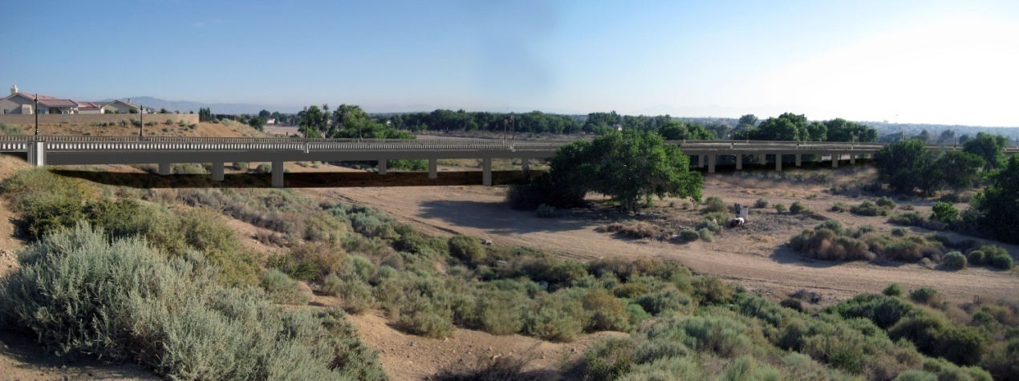
Capital Improvement Projects
Yucca Loma Bridge Construction - $370,000
  Bridge Structure is Completed!
  Construction activities related to restoration area maintenance and bridge’s art work are ongoing.

Slide 32
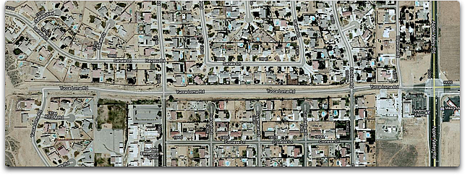
Capital Improvement Projects
Yucca Loma Road widening (from bridge to Apple Valley Road) - $5.3m

Slide 33
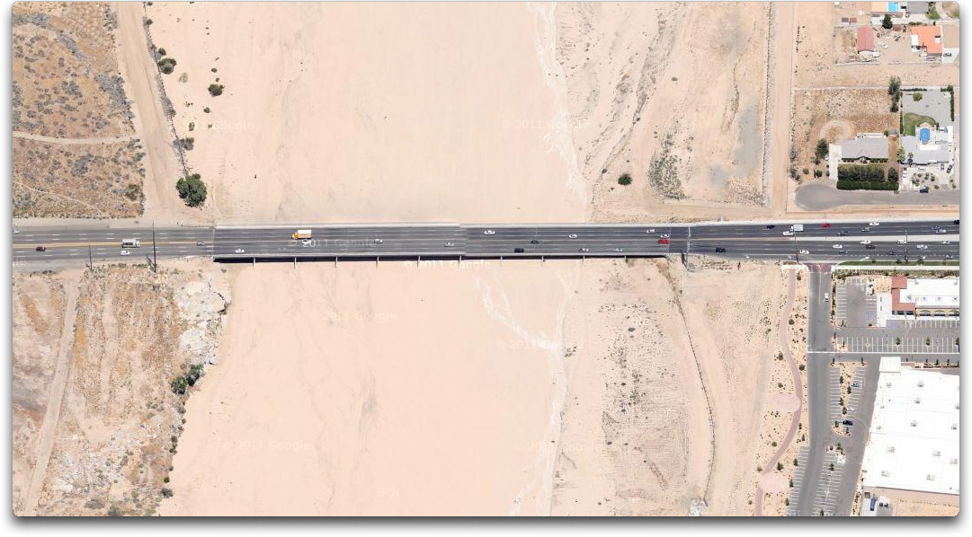
Capital Improvement Projects
Bear Valley Bridge rehabilitation design work - $480k
  Will consist of six east/west travel lanes, center median, shoulders and class 1 bikeway.

Slide 34
Capital Improvement Projects
Apple Valley/Tuscola Signal $380k
Bear Valley bikepath - $196k
Mojave Riverwalk South $923k
Dale Evans/Waalew Realign.* $280k
Yucca Loma Elem. SRTS $424k
Lafayette St.(Dale Evans to
Navajo) $1.0m
*Design only

Slide 35
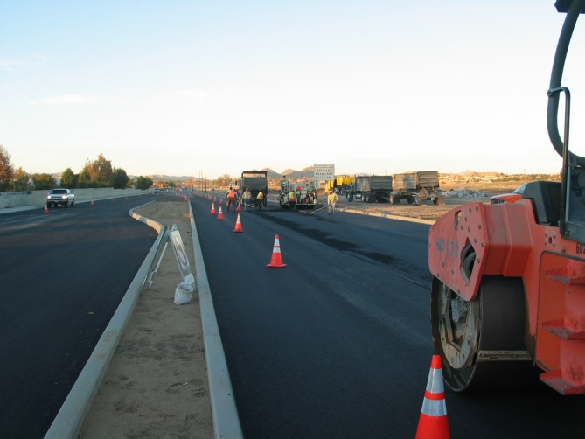
Capital Improvement Projects
  Town-wide Paving Priorities per PMS - $1m
FY16-17 CIP - 25 projects totaling $10.9m

Slide 36
CIP FUNDING: Ten-Year Historical Comparison
36

Slide 37
Fiscal Year 2016-2017
Proposed Budget
DEPARTMENT/PROGRAM
HIGHLIGHTS
37
Notes:
37

Slide 38
Department/Program
Appropriations
Town Council
FY 16-17 Appropriations $ 245,396
FY 15-16 Prop. Approp. 228,777
Amount Increase $ 16,619
Percent Increase 7.3%
Key changes: Increased benefit contract costs

Slide 39
DEPARTMENT/PROGRAM HIGHLIGHTS/GOALS
Council:
  Apple Valley named Best City to live in High Desert fifth year in a row
  Secured Federal grant funding towards acquisition of the Hilltop House and closed on sale. Site to be used for Legacy Trail Parkland
  Participated in third multi-agency federal legislative advocacy collaboration
  Presented second annual Mayor’s Youth Leadership Summit
  Presented second Mayor’s Weight Loss Challenge
  Received the League of Ca Cities – Desert Mountain Division Larry Chimbole Award
  Served on League of CA Cities Executive Board and participated in Annual Conference and various quarterly policy committee assignments
  Served on several state-wide, regional, joint powers authorities, committees and commissions

Slide 40
Department/Program
Appropriations
Town Manager
FY 16-17 Appropriations $ 602,194
FY 15-16 Prop. Approp. 580,301
Amount Increase $ 21,893
Percent Increase 3.8%
Key changes: Increased benefit contract costs

Slide 41
DEPARTMENT/PROGRAM HIGHLIGHTS/GOALS
Town Manager:
  Secured third $75,000 in County Econ. Dev. grant funds for High Desert regions first collaborative participation at 2015 ICSC conference
  Commenced submission of several State and Federal competitive grant applications resulting in $2.4 million in grant awards
  Participated in first annual High Desert Leadership Academy mentorship program
  Received the League of Ca Cities – Desert Mountain Division Larry Chimbole Award

Slide 42
Department/Program
Appropriations
Town Clerk
FY 16-17 Appropriations $ 499,843
FY 15-16 Prop. Approp. 441,754
Amount Increase $ 58,089
Percent Increase 13.1%
Key changes: Increased benefit contract costs, Presidential and Primary Election

Slide 43
DEPARTMENT/PROGRAM HIGHLIGHTS/GOALS
Town Clerk:
  Codified 100% of Muni Code within 30 day timeframe
  Created viewing station for members of the public to view records manually and/or electronically
  Continued Internship Program in collaboration with local high schools
  Continued extended hours for passports processing services resulting in increased applications
  Imported all TOAV claims into claims tracking software
  Completed review of Town’s records based upon approved retention schedule
  Participating as an Early Voting Site
  Preparing for Successful Primary and General Elections

Slide 44
Department/Program
Appropriations
Finance
FY 16-17 Appropriations $ 1,223,766
FY 15-16 Prop. Approp. 1,212,265
Amount Increase $ 11,501
Percent Increase 0.9%
Key changes: Increased benefit contract costs

Slide 45
DEPARTMENT/PROGRAM HIGHLIGHTS/GOALS
Finance department:
  Received GFOA Certificate of Achievement for Excellence in financial reporting for 13th consecutive year
  Received GFOA Distinguished Budget Presentation Award for 3rd time in Town’s history
  Received CSMFO Operating Budget Excellence Award for 2nd time
  Continued reformatting budget document to improve financial reporting practices and public disclosure of financial information
  Implemented new GASB accounting standards
  Completed 2 Recognized Obligation Payment Schedules and 2 Meet and Confer processes with the State Dept. of Finance re. RDA dissolution activities
  Continued to annually update user fees as part of Master Fee Resolution process and reformat Municipal Fee Schedule
  Applied for APTUS&C Investment Policy Certification Award

Slide 46
Department/Program
Appropriations
Public Information
FY 16-17 Appropriations $ 536,097
FY 15-16 Prop. Approp. 549,910
Amount Decrease $ (13,813)
Percent Decrease -2.5%
Key changes: Increased benefit contract costs, various minor line item account reductions

Slide 47
DEPARTMENT/PROGRAM HIGHLIGHTS/GOALS
Public Information
  Issued 3rd AV Foundation Annual Report
  Launched redesigned and upgraded Town website
  Grew social media outreach by 109% - total across all platforms: 31,554 (Top ten Facebook posts reached over 122,000 people)
  Placed 40 print, radio and online ad campaigns for various programs and services
  SAVE campaign raised $70k plus in-kind donations of $45k
  Managed “H2Ours” outreach campaign for water system acquisition, reaching 70% approval rating
  Two clean up days resulted in removal of 71 tons of trash/recyclables
  Initiated implementation of PEG channel programming on Channels 187 for Charter and 25 for Frontier

Slide 48
Department/Program
Appropriations
Human Resources
FY 16-17 Appropriations $ 503,758
FY 15-16 Prop. Approp. 475,531
Amount Increase $ 28,227
Percent Increase 5.9%
Key changes: Increased benefit contract costs

Slide 49
DEPARTMENT/PROGRAM HIGHLIGHTS/GOALS
Human Resources:
  Successfully negotiated costs savings in health care provider contracts
  Secured tuition discounts through Brandman and Redlands Univ. for employees seeking additional education
  Developed the Town’s Affordable Care Act tracking and reporting program
  Conducted extensive review of job descriptions and updated based upon core competencies
  Healthy workforce initiatives contributed to decreased liability for health insurance premiums through CJPIA
  Achieved significant reduction in workplace injuries through increased safety training
  Collaborated with SBC Sheriff’s dept to facilitate on-site active shooter training

Slide 50
Department/Program
Appropriations
Public Safety
FY 16-17 Appropriations $ 12,919,007
FY 15-16 Prop. Approp. 12,571,868
Amount Increase $ 347,139
Percent Increase 2.8%
Key changes: Increased County Sheriff contract costs

Slide 51
DEPARTMENT/PROGRAM HIGHLIGHTS/GOALS
Public Safety
  Overall, crime reduced in 2015 by 7%
  (5% increase in part 1 crimes, 14% reduction in part 2 crimes)
  Operated multiple grant funded sobriety checkpoints resulting in 16.5% increase in detected DUI offenses
  Deputies made 13% more arrests in 2015 compared to 2014
  AVPD volunteers donated 13,796 hours resulting in
  $584k in estimated cost savings
  Deputies recovered property totaling over $880,000
  Deploy bicycle patrol for TOAV events
  Continued social media campaign using Facebook and Twitter to disseminate pertinent information to communities within the County

Slide 52
Department/Program
Appropriations
Animal Shelter
FY 16-17 Appropriations $ 1,980,176
FY 15-16 Prop. Approp. 2,047,508
Amount Decrease $ (67,332)
Percent Decrease (3.3%)
Key changes: Increased benefit contract costs, reorganization and revision of staffing assignments/ complement

Slide 53
DEPARTMENT/PROGRAM HIGHLIGHTS/GOALS
Animal Shelter:
  Renegotiated Sheltering Agreement w/ County increasing operating and capital contributions $383k
  Took over annual inspection/permitting process for Animal related businesses from County – 136 Animal keeping permits issued
  Received 75,417 pounds of donated pet food saving approximately $26,400
  Partnered with local businesses and veterinarians to “save lives” by helping low income owners with spay/neuter raising over $21,000
  Attempted World Record for largest dog obedience lesson
  Received 75k pounds of food donations from Walmart distribution center saving over $26k

Slide 54
Department/Program
Appropriations
Environmental & Transit Services
FY 16-17 Appropriations $ 380,140
FY 15-16 Prop. Approp. 397,906
Amount Decrease $ (17,766)
Percent Decrease (4.5%)
Key changes: Increased benefit contract costs, various minor line item account reductions

Slide 55
DEPARTMENT/PROGRAM HIGHLIGHTS
Environmental & Transit Services:
  Initiated creation of Community Choice Aggregation (CCA) program to decrease electrical costs for Town residents
  Operated a Shred-fest for Town residents serving 148 households shredding 384 boxes of documents
  Recognized two TOAV businesses for Green Spirit Award
  Sponsored Greener Way of Life program

Slide 56
Department/Program
Appropriations
Code Enforcement
FY 16-17 Appropriations $ 1,045,454
FY 15-16 Prop. Approp. 1,018,381
Amount Increase $ 27,073
Percent Increase 2.7%
Key changes: Increased benefit contract costs

Slide 57
DEPARTMENT/PROGRAM HIGHLIGHTS
Code Enforcement:
  Achieved 72% reduction in graffiti over last five years
  Increased trash collected (178,740 pounds) at clean up events provided to residents at no cost
  Successfully implemented paperless processes reducing printed pages by 65-75,000
  5,750 cases opened, 71% proactively
  3,086 tires collected using Tire Amnesty and Tire Clean-up grants
  Work with property owners to obtain more voluntary compliance

Slide 58
Department/Program
Appropriations
Public Works
FY 16-17 Appropriations $21,971,659
FY 15-16 Prop. Approp. 21,362,409
Amount Increase $ 609,250
Percent Increase 2.9%
Key changes: Increased benefit contract costs, annual contract cost increases for tipping fees, sewage treatment. Includes appropriations for Street Maintenance Fund, Wastewater (Sewer) Fund, Waste Management (Solid Waste) Fund

Slide 59
DEPARTMENT/PROGRAM HIGHLIGHTS
Public Works:
  Performed wet-well bypassing and cleaning at all 9 lift stations
  Replaced or repaired 6 sections of roadway
  Continued sewer manhole rehabilitation project (yr3 of 7)
  Installed new motors at Kissel and AD# 3A2 sewer lift stations and repaired motor at AD# 3A1 station
  Conserved water at parks and landscape districts in compliance with State mandates
  Approx. 125 local drainage structures inspected and cleaned
  Approx. 150 roadway signs replaced/installed

Slide 60
Department/Program
Appropriations
Parks and Recreation
FY 16-17 Appropriations $ 3,176,403
FY 15-16 Prop. Approp. 3,220,538
Amount of decrease $ (44,135)
Percent decrease (1.4%)
Key changes: Increased benefit contract costs, various minor line item account decreases

Slide 61
DEPARTMENT/PROGRAM HIGHLIGHTS
Parks and Recreation:
  Replaced lighting in mini-gym and main gymnasium.
  Hosted 6 large scale soccer tournaments at Lenny Brewster Sports Center.
  Installed outdoor exercise equipment and basketball court at Mendel Park.
  Continued increased participation in Teen Art Festival to include more than 400 entries
  Initiate implementation of online registration program.
  Partner with local non-profits to host multiple aquatic events

Slide 62
Department/Program
Appropriations
Community Development
FY 16-17 Appropriations $ 1,355,072
FY 15-16 Prop. Approp. 1,441,379
Amount Decrease $ (86,307)
Percent Decrease (6.0%)
Key changes: Increased benefit contract costs, decreased grant funding

Slide 63
DEPARTMENT/PROGRAM HIGHLIGHTS
Community Development:
  Entitled over 400 single-family residential lots
  Continuing update of Multi-species habitat conservation plan
  Provided assistance to 25 low-income individuals and families needing critical home repairs
  Continued pursuit of CEQA compliance for project Jupiter
  Completed CEQA process for Liberty acquistion
  Administered the servicing of 350 housing loans that assisted low income residents with home purchases or rehabilitation of owner-occupied homes

Slide 64
Department/Program
Appropriations
Economic Development
FY 16-17 Appropriations $ 105,750
FY 15-16 Prop. Approp. 107,945
Amount Decrease $ (2,195)
Percent Decrease (2.0%)
Key changes: Increased benefit contract costs, various minor line item reductions

Slide 65
DEPARTMENT/PROGRAM HIGHLIGHTS
Economic Development:
  Successfully attracted 1.3 million square feet distribution center
  Approved funding agreement for regional street improvements adjacent to distribution center
  Promoted Apple Valley to key industrial site selectors via direct contact and site tours
  Helped attract new commercial retailers such as Jimmy John’s Subs, Salon 18 Suites, Off the Grid Brewery, etc.
  Started Business Visitation Program
  Developed leads from ICSC conference
  Helped lead marketing partnership Opportunity High Desert partnership

Slide 66
FISCAL YEAR 2016-2017
PROPOSED BUDGET
Copies available for Public Viewing at:
- Town Clerk’s Office at 14955 Dale Evans Parkway (Town Hall)
- Town’s Website: www.applevalley.org
Additional information contact 760-240-7000

Slide 67
FISCAL YEAR 2016-2017
PROPOSED BUDGET
PUBLIC HEARING TO CONSIDER ADOPTION OF THE FY 16-17
PROPOSED BUDGET -
Tuesday, June 14th ,2016 at 6:30pm in the Council Chambers

Slide 68

Town of Apple Valley
FISCAL YEAR 2016-2017 PROPOSED BUDGET
Budget Study Session
May 31, 2016
Questions?

