Slide 1
Town of Apple Valley
Mid-Year Budget Status Report Fiscal Year 2014-15 Town Council Meeting
February 24, 2015

Slide 2
FY 14-15 Mid-Year Budget Status Report Agenda
Brief review of FY14 year-end
Fund balance overview
FY14-15 Revenue year-to-date
FY14-15 Expenditures year-to-date
End of year projections FY2014-15
Factors affecting FY2015-16 Budget development
Questions/comments from Town Council

Slide 3
FY 2014-15 Mid-Year Budget Status Report
Staff recommends that Town Council receive and file the Fiscal Year 2014-2015 Mid-Year Budget Status Report;
Mid-Year Budget Status Staff Report
Budget Adjustment Number 15-15 including budget adjustments - all funds
Exhibit A – Mid Year Budget Adjustment Summary
Budget to Actual Comparison by Fund/Department/Division
General Fund Revenue Projections
Projected Fund Balances – June 30, 2015

Slide 4
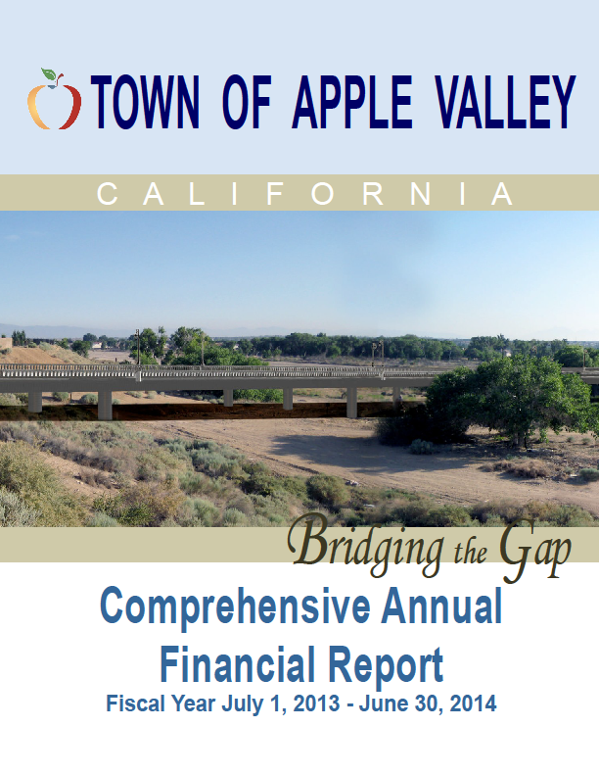
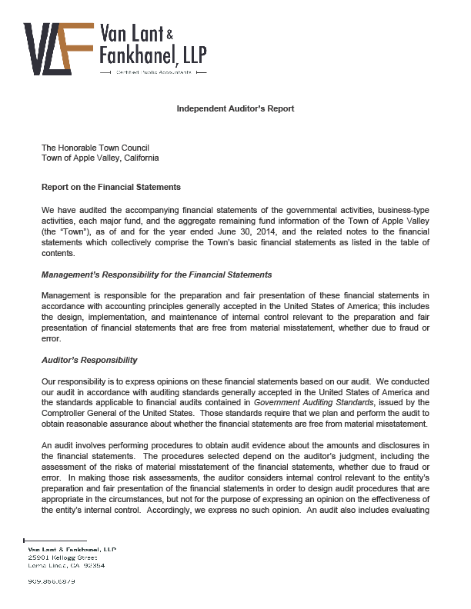
FY 2013-14 Fiscal Year-End (CAFR available at www.applevalley.org)

Slide 5
FY 2013-14 Fiscal Year-End
General Fund only –
Total Revenues $ 21,193,185
Total Expenditures
(inc. net transfers) $ 20,227,303
Net change $ 965,882
Fund Balance BOY $ 17,340,269
Fund Balance EOY $ 18,306,151

Slide 6
FY 2013-14 Fiscal Year End
FY 2013-14 Ending Fund Balance $ 18,306,151
Non-spendable $ 9,497,516
Restricted $ - 0 -
Committed $ 4,730,937
Assigned $ - 0 -
Unassigned $ 4,077,698*
* 1) 15.6% of the FY 14-15 General Fund Amended Budget
2) Parks & Rec. Fund accumulated fund deficit – ($6,435,006)
Notes:
AVGC deficit at 6/30/14 is $1,847,400

Slide 7
FY 2013-14 Fiscal Year-End
General Fund Only -
 | Amended Budget | Actual | Variance | % change
Total Revenues | $21,784,864 | $22,233,553 | $ 448,689 | 2.06*
Expenditures | $20,717,248 | $21,267,671 | $(550,423) | 2.66*
Net Change in Fund Balances | $ 1,067,616 | $ 965,882 | $(101,734) | (9.53)
* Includes Net Transfers

Slide 8
FY2014-15 Mid-Year Budget Status Report: General Fund Estimated Revenues
Total $26,054,809
8

Slide 9
PROPERTY TAX HISTORY General Fund
9
Notes:
Slope line correspondingly follows recessionary line

Slide 10
PROPERTY TAX – Sales Tax Backfill – General Fund
10
Notes:
Slope line correspondingly follows recessionary line

Slide 11
SALES TAX COLLECTIONS By Business Categories – CY 2014
11

Slide 12
SALES & USE TAX HISTORY – General Fund
12

Slide 13
FY 14-15 Adopted Budget
General Fund Summary
Estimated Revenues | $ 20,234,502
Transfers In | 5,820,307
Total Resources | $ 26,054,809
Adopted Budget | $ 25,887,310
Approp. To Fund Balance | 167,499
Balance | -0-

Slide 14
FY 2014-15 General Fund – Summary of Adjusted Estimated Revenues
Adopted Revised
Property Tax $3,330,600 $2,402,600
Property Tax – Sales Tax Backfill 1,460,500 1,564,300
Property Tax – VLF Backfill 5,356,000 5,500,800
Sales & Use Tax 4,177,500 4,311,300
Franchise Tax 1,930,000 2,072,000
Business License Fee 185,000 152,000
Fines and Fees 100,000 70,000
Animal Services 761,100 902,400
Code Enforcement 268,500 330,000
Building and Safety 595,000 625,000
Other Revenues 780,000 1,670,900
Total General Fund Adj. Revenues $19,157,200 $19,731,300
*Net Increase - $574,100

Slide 15
FY 2014-15 General Fund – Summary of Proposed Approp. Adjustments
Appropriation adjustments (Expenditures);
Contract Services $ 96k
Info. Tech. Services $ (68k)
Legal Fees/Services $ 156k
Building Maintenance $( 18k)
Insurance Costs $(43k)
County Sherriff $108k
Gasoline, Diesel, Oil $(50k)
Misc. Approp. Adj. $ 26k
Sub-total Appropriation Adjustments $207k

Slide 16
FY 2014-15 General Fund: BA 15-15 Amended Budget
General Fund Summary
Estimated Revenues | $20,234,502
Rev. Adjustments | 574,100
Transfers In | 5,820,307
Total Resources | $26,628,909
Adopted Budget | $25,887,310
Proposed Approp. Adj. | 207,392
Total Adj. Appropriations | $26,094,702
Approp. To Fund Balance | 534,207
Balance | -0-

Slide 17
Factors Affecting Development of the Ensuing FY 2015-16 Budget
Effect of Key Economic Impacts:
Sales tax collections projected to increase by approx. 2.0%
Property tax projected growth - 4.0-6.0%?
AV Golf Fund will be closer to break even
Implementation of GASB 68
Service cost shifts to local govt.

Slide 18
Factors Affecting Development of the Ensuing FY 2015-16 Budget
Effect of State Budget / Local Impacts:
Gov. Brown’s elimination of RDAs
Annual Fiscal Impact:
$6.6m total loss in tax increments
$1.8m from VVEDA pass-through payments
$4.8m loss in AV Project area II increment.
$7.1m in unspent bond proceeds
Debt outstanding (3 issues) PA1 - $15.1m PA2 -$33.2m
Successor agency continues to pay off debt
ROPs Outstanding Issues - $3.3m
Unknown legislative impacts
Triple Flip, RDA, Sales Tax exemptions

Slide 19
FY15-16 Budget Development Considerations:
Fiscal Tenet – No new services/expansion of Programs or
services without identified funding source.
Must either;
Increase revenue sources, or
Decrease level of service delivery, or
Some combination of both strategies.

Slide 20
Town of Apple Valley
Standard & Poor’s bond rating recently upgraded to A from A-

Slide 21
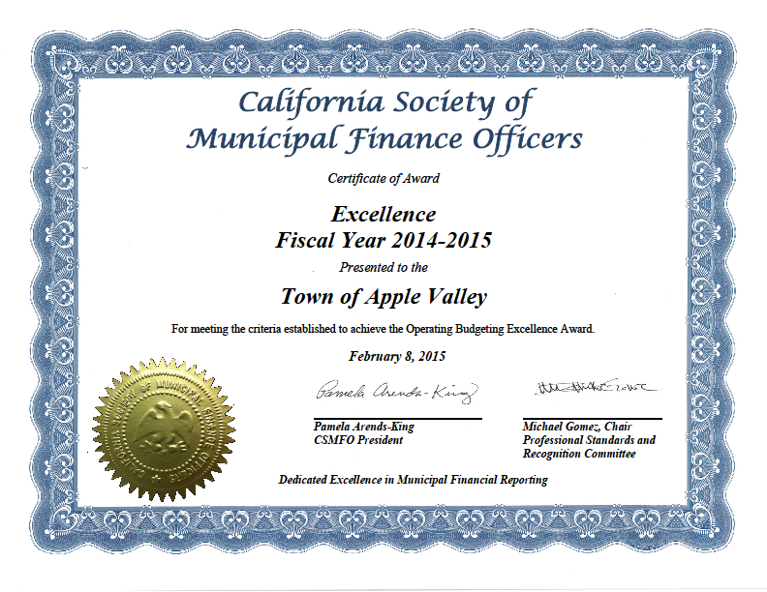
Town of Apple Valley

Slide 22
Town of Apple Valley
Mid-Year Budget Status Report Fiscal Year 2014-15
Questions?

