Slide 1

Town of Apple Valley
FISCAL YEAR 2015-2016 PROPOSED BUDGET
Budget Study Session
May 28, 2015

Slide 2

BUDGET STUDY SESSION
Study Session Agenda:
  Brief Review of Document Changes
  Overview of Proposed FY15-16 Budget including Department/Program Highlights
  Provide Information on Timeline for Adoption of Budget
  Questions/comments from Town Council

Slide 3
FY 15-16 Budget document Format
Continued implementation of “Best Practices Approach” (Multi-year process)
Goal: Increase transparency and understandability of budget document
Key changes this year:
  Performance Measure/Workoad Indicators
  Adding narrative/fund descriptions
  Received GFOA Distinguished Budget Presentation Award for the second time
  Received CSMFO Operating Budget Excellence Award
  Only City in High Desert to Receive these Awards
  In top 1.1% of local government agencies nationwide
Notes:
Operating and Capital Improvement Budget Summary document, 4 year budget summary – all funds, calc. of legal debt margin, desc of bonded debt obligations, schedule of bonded debt service req.s to maturity, schedule of L.T. debt outstanding, Sales, Property and Franchise Fee summaries, ten year history of assessed values.

Slide 4
FY 15-16 BUDGET PROCESS
January
February
Finance
Analyze & Project
Revenue Estimates
Council provides input
to staff on Council’s
priorities for
FY15-16 Budget
December
BUDGET
KICK-OFF
January/February
February/March
Departments
Submit Budget
Requests to Finance
Finance analyzes
Budget Requests/Finalize
Revenue Projections/
Mid-Year Budget Review
March
April
April
Town Manager holds
Budget Hearings
with Departments
Proposed Capital
Improvement Program
Finalized
Finance Staff
Prepares Proposed Budget
May
June
June 09th
Town Manager
Submits Proposed Budget
To Town Council
Council/Town Manager
Conduct Budget Study
Session & Employee
Orientation Meeting
Town Council
Holds Public Hearing
And Adopts Budget

Slide 5
FY15-16 Proposed Operating and Capital Improvement Budget
Represents Management’s Recommended Budget to;
  Address Town Council’s priorities within
  Existing Financial Constraints to
  Fulfill the Service Requirements of the Community.

Slide 6
Challenges Faced in Developing FY15-16 Proposed Budget
Gap between community “expectations” and “financial reality” has gradually widened over past several years.
  New programs and services added annually over last ten years
  No new revenues to fund growth in services
  Coupled with annual inflationary increases in all other expenditures
Now in sustained period of slow growth – Revenues are growing but still not keeping pace with Expenditure increases

Slide 7
Challenges Faced in Developing FY15-16 Proposed Budget
Focus is on sustainability – scaling expectations and service levels to levels that are supportable within current fiscal constraints.
Continued implementation of austerity measures.
No programs or services added without a source of funding to pay for the expansion in service delivery.

Slide 8
BUDGET SUMMARY
All Funds (including transfers)
FY 15-16 Estimated Revenues $ 91,836,278
Utilization of Fund Balance 11,413,180
FY 15-16 Total Resources $ 103,249,908
FY 15-16 Appropriations $ 103,249,908

Slide 9
TOTAL APPROPRIATIONS
All Funds – Current v. Proposed
FY 14-15
Adopted
FY 15-16
Proposed

Slide 10
TOTAL OPERATING BUDGET
All Funds
Proposed FY 15-16 $ 52,801,209
Adopted FY 14-15 52,638,040
Amount of Increase $ 163,169
Percent Increase 0.31 %

Slide 11
TOTAL CAPITAL IMPROVEMENT BUDGET - All Funds
Proposed FY 15-16 $ 29,824,920
Adopted FY 14-15 33,412,127
Amount of Decrease $ (3,587,207)
Percent Decrease (10.74 %)

Slide 12
TOTAL APPROPRIATIONS
By Fund Type
Total $103,249,908

Slide 13
DISTRIBUTION OF SALARIES & BENEFITS
- All Funds
Total $11,057,276
County Sheriff - $12,016,336

Slide 14
GENERAL FUND SUMMARY
FY 15-16 Est. Revenues Transfers In FY 15-16 Total Resources FY 15-16 Proposed Budget * Approp. to Fund Balance | $ 20,768,094 7,545,902 $ 28,313,996 28,102,544 $ 211,452
* Includes Transfers Out
Notes:
Refer to “Note 1” on page 5

Slide 15
SUMMARY OF APPROPRIATIONS
By Major Service Program – General Fund
Total $28,102,544

Slide 16
GENERAL FUND APPROPRIATIONS
FY 15-16 Proposed $ 28,102,544*
FY 14-15 Adopted 25,887,311
Amount Increase $ 2,215,233
Percent Increase 8.56 %
*Transfer to Parks & Rec. Fund = $1,072,660
*Transfer to AV Golf Course Fund = $ 349,968
Notes:
FY 13-14 P&R Transfer = $545,885, AVGC FY13-14 Transfer = $333,892

Slide 17
GENERAL FUND RESOURCES
Including Transfers In
Total $28,313,996

Slide 18
SALES & USE TAX
General Fund – includes Sales Tax In-Lieu
FY 15-16 Estimated Revenue $ 5, 985,000*
FY 14-15 Estimated Revenue 5,651,100
Amount of Increase $ 333,900
Percent Increase 5.91%
* Includes adj. for “Triple Flip” true-up payment

Slide 19
SALES TAX COLLECTIONS
By Business Categories – CY 2014

Slide 20
SALES & USE TAX HISTORY
General Fund – Includes ST In-Lieu

Slide 21
PROPERTY TAX
General Fund
FY 15-16 Estimated Revenue $ 3,484,000
FY 14-15 Estimated Revenue 3,218,000*
Amount Increase $ 266,000
Percent Increase 8.3 %
* As revised at Mid Year

Slide 22
PROPERTY TAX HISTORY
General Fund – (Exc. Sales Tax Backfill and VLF Backfill)
Notes:
Slope line correspondingly follows recessionary line

Slide 23
PARKS AND RECREATION FUND SUMMARY
FY 15-16 Est. Revenues Net Transfers In FY 15-16 Total Resources FY 15-16 Proposed Budget | $ 2,575,264 613,512 $ 3,188,776 $ 3,188,776
23
Notes:
23
Refer to “Note 1” on page 5

Slide 24
AV GOLF COURSE FUND SUMMARY
FY 15-16 Est. Revenues Transfers In FY 15-16 Total Resources FY 15-16 Proposed Budget | $ 718,500 349,968 $ 1,068,468 $ 1,068,468
24
Notes:
24
Refer to “Note 1” on page 5

Slide 25
BUDGET SUMMARY
All Funds (including transfers)
FY 15-16 Estimated Revenues $ 91,836,278
Utilization of Fund Balance 11,413,180
FY 15-16 Total Resources $ 103,249,908
FY 15-16 Appropriations $ 103,249,908
25

Slide 26
BUDGET SUMMARY
All Funds (including transfers)
FY 15-16 Appropriations $ 103,249,908
FY 14-15 Appropriations ($ 105,479,311)
Total Decrease ($ 2,229,403)
(2.11%)
26

Slide 27

Fiscal Year 2015-2016
Proposed Budget
CAPITAL IMPROVEMENT PROGRAM
HIGHLIGHTS
27
Notes:
27

Slide 28
TOTAL CAPITAL IMPROVEMENT BUDGET - All Funds
Proposed FY 15-16 $ 29,824,920
Adopted FY 14-15 33,412,127
Amount of Decrease $ 3,587,207
Percent Decrease -10.74 %
28

Slide 29
Capital Improvement Projects
CIP Process
  CIP project reviews began in Fall 2014
  Identified existing projects in the current year that had remaining appropriations that could be returned to reserves
  Reviewed prioritization criteria and prioritized projects
  Reviewed current capacity - staff’s ability to start and complete projects as budgeted
  Staff meets to get input on the CIP Plan and discuss during departmental budget hearings

Slide 30
Capital Improvement Projects
Highlights of Projects Proposed for Funding in FY 15/16:
  36 Projects planned for design and construction
  Total CIP Budget for FY 15-16 - $29.8m

Slide 31
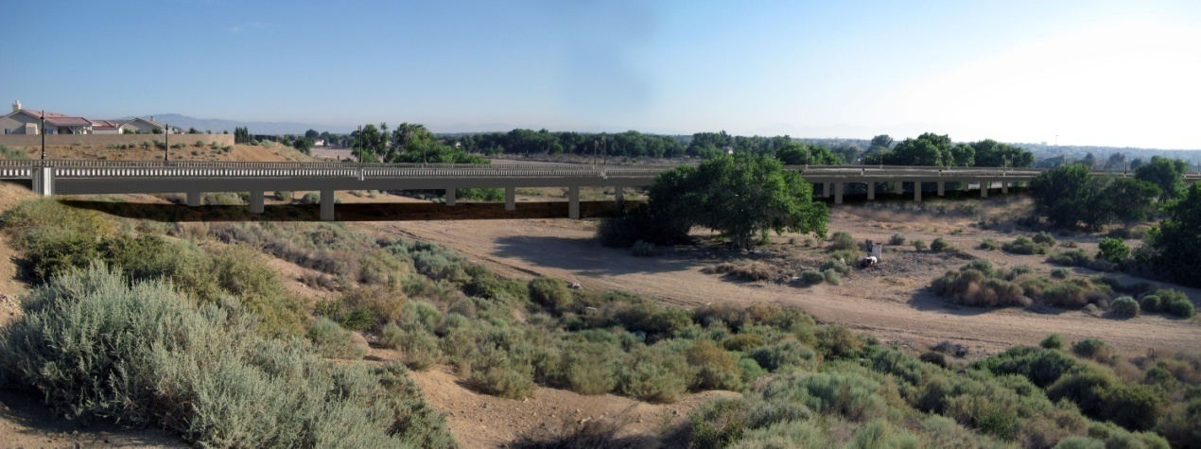
Capital Improvement Projects
Yucca Loma Bridge Construction - $11.8m
  Under Construction Now
  Progress can be viewed from cameras linked to Town’s website @ www.applevalley.org

Slide 32
Capital Improvement Projects
Yucca Loma Road widening (from bridge to Apple Valley Road) - $13.2m
Two Yucca Loma projects total
$25m of total $29.8m CIP budget for
FY 15-16

Slide 33
Capital Improvement Projects
Bear Valley Bridge rehabilitation design work - $1.0m
Apple Valley/Tuscola Signal $380k
Bear Valley bikepath - $356k
Hwy 18/Mojave Riverwalk S $923k
Dale Evans/Waalew Realign.* $300k
Bear Valley Bridge* $1.0m
*Design only

Slide 34
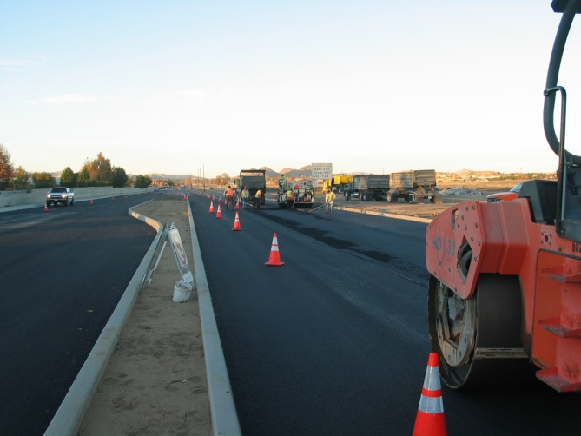
Capital Improvement Projects
  Town-wide Paving Priorities per PMS - $1m
FY15-16 CIP - 36 projects totaling $29.8m

Slide 35
CIP FUNDING: Ten-Year Historical Comparison
35

Slide 36
Fiscal Year 2015-2016
Proposed Budget
DEPARTMENT/PROGRAM
HIGHLIGHTS
36
Notes:
36

Slide 37
DEPARTMENT/PROGRAM HIGHLIGHTS/GOALS
Council:
  Awarded Construction contract for the Yucca Loma Bridge; Estimated completion date – October, 2015
  Apple Valley named Best City to live in High Desert fourth year in a row
  Participated in second multi-agency federal legislative advocacy collaboration
  Introduced first annual Mayor’s Youth Leadership Summit
  Broke ground on VVWRA Subregional Wastewater Treatment plant to supply Town with reclaimed water
  Developed several economic development leads through ICSC conference
  Participated in League of CA Cities Annual Conference and various quarterly policy committee assignments
  Served on several state-wide, regional, joint powers authorities, committees and commissions

Slide 38
DEPARTMENT/PROGRAM HIGHLIGHTS/GOALS
Town Manager:
  Secured second $75,000 in County Econ. Dev. grant funds for High Desert regions first collaborative participation at 2014 ICSC conference
  Reorganized Tri-agency EOC Operations
  Outsourced IT saving over $220,000
  Commenced submission of several State and Federal competitive grant applications resulting in $2.5 million in grant awards
  Participated in first annual High Desert Leadership Academy mentorship program

Slide 39
DEPARTMENT/PROGRAM HIGHLIGHTS/GOALS
Town Clerk:
  Successfully conducted 2 Elections
  Contracted with codifying service for maintenance of Muni Code
  Continued Internship Program in collaboration with local high schools
  Continued extended hours for passports processing services resulting in increased applications
  Imported all TOAV claims into claims tracking software
  Completed review of Town’s records based upon approved retention schedule

Slide 40
DEPARTMENT/PROGRAM HIGHLIGHTS/GOALS
Finance department:
  Received GFOA Certificate of Achievement for Excellence in financial reporting for 12th consecutive year
  Continued reformatting budget document to improve financial reporting practices and public disclosure of financial information
  Received GFOA Distinguished Budget Presentation Award for 2nd time in Town’s history
  Received CSMFO Operating Budget Excellence Award for 1st time
  Implemented new accounting standards
  Completed 2 Recognized Obligation Payment Schedules and 3 Meet and Confer processes with the State Dept. of Finance re. RDA dissolution activities
  Continued to update user fees as part of Master Fee Resolution process and reformat Municipal Fee Schedule
  Reformatting Treasurer’s Report
  Applied for APTUS&C Investment Policy Certification Award

Slide 41
DEPARTMENT/PROGRAM HIGHLIGHTS/GOALS
Public Information
  Issued 2nd AV Foundation Annual Report
  Completed redesign and overhaul of website
  Grew social media outreach across all platforms by 15,095
  Expanded sponsorship development efforts
  Presented 29 public events and presented or assisted with 15 employee events
  SAVE campaign raised $73k plus in-kind donations of $38k
  Booked 21 local bands for Town events, supporting local business and talent
  Two clean up days – 650 volunteers, 66 tons of trash/recyclables, and 100 pizzas.

Slide 42
DEPARTMENT/PROGRAM HIGHLIGHTS/GOALS
Human Resources:
  Successfully negotiated costs savings in health care provider contracts
  Realigned employee benefits offerings providing enhanced services and cost savings for employees and the Town
  Develop master training calendar with comprehensive listing of training offered for Town staff
  Conducted extensive review of job descriptions and updated based upon core competencies
  Successfully reduced CJPIA cost by almost $750k through Risk Management efforts and managing workers comp. claims

Slide 43
DEPARTMENT/PROGRAM HIGHLIGHTS/GOALS
Public Safety
  Overall, crime reduced in 2014 by 5%
  (1% increase in part 1 crimes, 8% reduction in part 2 crimes)
  Operated multiple grant funded sobriety checkpoints
  Deputies recovered $697k in property
  COP volunteered 10,123 hours ($266k in cost savings)
  528 participants in Crime-Free multi-housing program
  Explorers volunteered 2,195 hours saving over $57.8k
  Reserve Deputies volunteered 2,016 hours saving over $271.5k

Slide 44
DEPARTMENT/PROGRAM HIGHLIGHTS/GOALS
Animal Shelter:
  Renegotiated Sheltering Agreement w/ County increasing operating and capital contributions $383k
  Implemented on-line Monthly Intake and Disposition Reports
  Developed partnerships with local veterinarians to maximize spay/neuter grant funding
  Updated cooperative agreements with over 75 animal rescue organizations to increase live-release rates
  Conducted ten Volunteer and “Me & My Shadow” orientation classes to increase volunteerism at Shelter
  Received 75k pounds of food donations from Walmart distribution center saving over $26k

Slide 45
DEPARTMENT/PROGRAM HIGHLIGHTS
Municipal Operations/Environmental & Transit Services:
  Maintained Sharps Container giveaway and exchange program at AVFPD
  Increased E-waste collection and revenues
  Installed 11 new advertising bus shelters and 4 non-advertising shelters
  Implemented Year 2 of NPDES Phase II Small MS4 General Permit

Slide 46
DEPARTMENT/PROGRAM HIGHLIGHTS
Code Enforcement:
  Achieved 68% reduction in graffiti over last four years
  Increased trash collected (160 tons) at clean up events provided to residents at no cost
  Successfully closed down all medical marijuana dispensaries
  Shut down three illegal internet gaming cafes
  Work with property owners to obtain more voluntary compliance

Slide 47
DEPARTMENT/PROGRAM HIGHLIGHTS
Public Works:
  20 roadway sectionals removed/replaced
  Replaced or repaired 12 sections of roadway
  Continued sewer manhole rehabilitation project (yr2 of 7)
  Completed wet-well bypassing at all nine lift stations
  Cleaned 10.3 miles of sewer mainline
  Video inspected 5.8 miles of sewer mainline
  76 local drainage structures inspected/cleaned
  68 roadway signs replaced/installed

Slide 48
DEPARTMENT/PROGRAM HIGHLIGHTS
Parks and Recreation:
  Received First 5 grant to continue and expand programming for pre-school children.
  Hosted 10 large soccer tournaments at Lenny Brewster Sports Center bringing in more than 50,000 people to the Town.
  Local track meet continued to be the largest local level Hershey’s track meet in Southern California (Rec. Supr. Recognized).
  Partnered with the Local Little league and Pony baseball organizations to make improvements at the ball fields at James Woody park.

Slide 49
DEPARTMENT/PROGRAM HIGHLIGHTS
Community Development:
  Completed 2014 Climate Action Plan update
  Entitled over 500 single-family residential lots
  Completed 2014-2021 update of the Housing Element
  Completed agreement w/ Cal Fish & Wildlife dept. for Multi-species habitat conservation plan
  Provided assistance to 20 low-income individuals and families needing critical home repairs
  Provided down payment assistance to 23 low-income individuals
  Completed acquisition and rehabilitation of a fourplex for transitional housing for domestic violence victims

Slide 50
DEPARTMENT/PROGRAM HIGHLIGHTS
Economic Development:
  Promoted Apple Valley to key industrial site selectors via direct contact and site tours
  Helped attract new commercial retailers
  Started Business Visitation Program
  Started Microenterprise Loan Program
  Developed leads from ICSC conference
  Advanced Opportunity High Desert partnership
  Named one of the nation’s top mid-sized cities in which to do business
  Name one of the “least costly cities for doing business” by Kosmont Companies/Rose Institute

Slide 51
FISCAL YEAR 2015-2016
PROPOSED BUDGET
Copies available for Public Viewing at:
- Town Clerk’s Office at 14955 Dale Evans Parkway (Town Hall)
- Town’s Website: www.applevalley.org
Additional information contact 760-240-7000

Slide 52
FISCAL YEAR 2015-2016
PROPOSED BUDGET
PUBLIC HEARING AND ADOPTION
Tuesday, June 09th ,2015 at 6:30pm in the Council Chambers

Slide 53

Town of Apple Valley
FISCAL YEAR 2015-2016 PROPOSED BUDGET
Budget Study Session
May 28, 2015
Questions?

