Slide 1

Town of Apple Valley
Mid-Year Budget Status Report
Fiscal Year 2015-16
February 23, 2016

Slide 2

FY 15-16 Mid-Year Budget Status Report Agenda
Brief review of FY15 year-end
  Fund balance overview
FY15-16 Revenue year-to-date
FY15-16 Expenditures year-to-date
End of year projections FY2015-16
Factors affecting FY2016-17 Budget development
Questions/comments from City Council

Slide 3
FY 2015-16 Mid-Year Budget Status Report
Staff recommends that Town Council receive and file the Fiscal Year 2015-2016 Mid-Year Budget Status Report;
    Mid-Year Budget Status Staff Report
    Budget Adjustment Number 16-14 including budget adjustments - all funds
    Exhibit A – Mid Year Budget Adjustment Summary
    Budget to Actual Comparison by Fund/Department/Division
    General Fund Revenue Projections
    Projected Fund Balances – June 30, 2016

Slide 4
FY 2014-15 Fiscal Year-End
General Fund only –
  Total Revenues $ 22,336,034
  Total Expenditures
  (inc. net transfers) $ 22,440,534
  Net change $ (104,500)
  Fund Balance BOY $ 18,306,151
  Fund Balance EOY $ 18,201,651

Slide 5
FY 2014-15 Fiscal Year-End
General Fund Only -
 | Amended Budget | Actual | Variance | % change
Total Revenues | $21,844,971 | $22,336,034 | $ 491,063 | 2.25*
Expenditures | $21,347,547 | $22,440,534 | $(1,092,987) | (5.12)*
Net Change in Fund Balances | $ 497,424 | $ (104,500)
* Includes Net Transfers

Slide 6
FY 15-16 Adopted Budget
General Fund Summary
Estimated Revenues | $ 20,768,094
Transfers In | 7,545,902
Total Resources | $ 28,313,996
Adopted Budget | $ 28,102,544
Approp. To Fund Balance | 211,452
Balance | -0-

Slide 7
FY 2015-16 General Fund Estimated Revenues
        Adopted Revised
Property Tax $3,170,000 $3,188,500
Property Tax – Sales Tax Backfill 664,000 365,200
Property Tax – VLF Backfill 5,665,800 5,806,600
Sales & Use Tax 5,321,000 5,539,900
Franchise Tax 2,073,000 2,073,000
Other Local Tax 191,000 218,600
Public Safety Fines and Fees 251,000 251,000
Public Services 1,560,300 1,548,200
Building and Safety 1,101,000 1,136,000
Planning Fees 180,700 180,700
Engineering 155,500 155,500
Other Revenues 7,980,696 7,977,896
Total General Fund Revenues $28,313,996 $28,479,796
*Net Increase - $165,800
Notes:
Includes advertising in bus stops of $38,700,

Slide 8
FY2015-16 Mid-Year Budget Status Report: General Fund Estimated Revenues
Total $28,479,796
8

Slide 9
PROPERTY TAX HISTORY
General Fund
9
Notes:
Slope line correspondingly follows recessionary line

Slide 10
PROPERTY TAX – Sales Tax Backfill – General Fund
10
Notes:
Slope line correspondingly follows recessionary line

Slide 11
SALES TAX COLLECTIONS
By Business Categories – CY 2015
11

Slide 12
SALES & USE TAX HISTORY – General Fund
12

Slide 13
Mid-Year Budget Status Report
FY 2015-16
State Budget – Local Impacts
What is “Triple Flip?” (taking of ¼ of Local Sales Tax):
  First Flip. ¼ cent of the local one-cent sales tax repealed. Impact to Apple Valley = 1.375 million.
  Second Flip. State dedicates ¼ of Local Sales Tax to repayment of State’s deficit reduction bonds (to be returned to Local gov’t. when bonds paid off).
  Third Flip. Sales tax revenue losses are backfilled from property taxes in the ERAF
    (Cities and Counties are sole funding source)
13

Slide 14
FY2015-16 Mid-Year Budget Status Report
Effect of State Budget / Local Impacts:
“Triple Flip” taking of ¼ of Local Sales Tax (January clean-up payment) was extended for several years due to issuance of additional “economic recovery bonds” (was set to sunset in 2010)
Final “clean-up payment set to be issued in May/June, 2016
14

Slide 15
FY2015-16 Mid-Year Budget Status Report
State’s “Triple Flip” and other subvention formulas:
Created budgetary and cash-flow considerations
Back-fill payments are made in January and May with final “true-up” payment in January of following year (versus monthly sales tax collections).
Revenues are harder to estimate
Loss of Investment Earnings
15

Slide 16
FY 2015-16 General Fund: Mid-Year Expenditure Adjustments
Appropriation adjustments (Expenditures);
  Contract Services $ 228k
  Legal Fees/Services $ 49k
  Tree Lighting $ 29k
  Gas, Diesel, Oil $(50k)
  Vehicle Maintenance $(50k)
  Insurance Costs $ 11k
  Other – Misc $ 81k
Sub-total Expenditure Adjustments $298k

Slide 17
FY 2015-16 General Fund: Amended Budget
General Fund Summary
Estimated Revenues | $20,768,094
Rev. Adjustments | 165,800
Transfers In | 7,545,902
Total Resources | $28,479,796
Adopted Budget | $28,102,544
Proposed Approp. Adj. | 298,230
Total Adj. Appropriations | $28,400,774
Approp. To Fund Balance | 79,022
Balance | -0-

Slide 18
Factors Affecting Development of the Ensuing FY 2016-17 Budget
Effect of State Budget / Local Impacts:
Less Transportation Funding - $0.022 per gallon decrease effect 7/1
  Other Transportation Taxes under consideration
Gov. Brown Proposed elimination of RDA
  Annual Fiscal Impact:
    $6.6m total loss in tax increments
    $1.8m from VVEDA pass-through payments
    $4.8m loss in AV Project area II increment.
  $16.6m in 20% set-aside funds for low-mod housing and unspent bond proceeds
  Debt outstanding (3 issues) PA1 - $15.9m PA2 -$35.2m
  Successor agency established to pay off debt
  ROPs Outstanding Issues - $1.8m

Slide 19
Factors Affecting Development of the Ensuing FY 2016-17 Budget
General Operating Fund:
Sales tax collections projected to increase by approx. 2.0%
Property tax projected growth - 3.0%
  Assessor’s growth projections not yet available
Annual review of user fees –

Slide 20
FY16-17 Budget Development Considerations:
General Operating Fund:
Baseline service levels have increased dramatically over the last 10 years.
Revenues have not increased at same pace as growth in service levels.
Annually review service delivery methods as part of budget development process
Fiscal Tenet – No new services/expansion of Programs or services without identified funding source.

Slide 21
FY16-17 Budget Development Considerations:
Parks and Recreation Fund (12 parks, 130 developed acres):
Parks and Rec. Ad Hoc Committee, April, 2012
Need to review Master plan (adopted May, 2013)
Current user fees are not able to support current levels of service delivery costs.
Baseline service levels have increased dramatically over the last 10 years.
Resources have not increased at same pace as growth in service levels.
21

Slide 22
FY16-17 Budget Development Considerations:
Parks and Recreation Fund (12 parks, 130 developed acres):
Per Master Plan – “Same vision that prompted higher level of investment over the past ten years was defined more formally in the Vision 2020 Strategic Plan”
  Affirmed Vision of the Community for;
    Improved Parks
    Engaging Community Events, and
    Increased recreational opportunities

Slide 23
Increased Service Delivery – last 10 years
Assumed operation of Parks District and park maintenance in 2001.
Expanded Brewster Park.
Added 20 acres of grass soccer/softball fields.
Built municipal pool and Civic Center Park.
Added amenities at Civic Center Park; amphitheatre, playground, dog park, fitness area, restrooms

Slide 24
Increase Service Delivery – last 10 years
Built new playground equipment in most parks.
Renovated skate park
Renovated Horsemen’s Center
Freedom festival
Started/expanded Summer Concert/Concert in the Park/Concert in the Courtyard series and fall festival Built new Development Services facility

Slide 25

Town of Apple Valley
Mid-Year Budget Status Report
Fiscal Year 2015-16
Questions?

Slide 26
FY 2014-15 Fiscal Year-End
FY 2014-15 Ending Fund Balance $ 18,201,651
Non-spendable $ 10,011,530
Restricted $ - 0 -
Committed $ 4,997,037
Assigned $ - 0 -
Unassigned $ 3,193,084*
* 1) 11.4% of the FY 15-16 General Fund Adopted Budget
2) Parks & Rec. Fund accumulated fund deficit – ($6,637,633)

Slide 27
Fund Balance - Definitions
27
General Fund Fund Balance (GASB 54 Compliant)
Nonspendable Fund Balance – That portion of fund balance that includes amounts that cannot be spent because they are either (a) not in spendable form, such as prepaid items, inventories of supplies, or loans receivable; or (b) legally or contractually required to be maintained intact, such as the principal portion of an endowment. This category was traditionally reported as a “reserved” fund balance under the old standard.
Restricted Fund Balance – That portion of fund balance that reflects constraints placed on the use of resources (other than nonspendable items) that are either (a) externally exposed by creditors (such as through debt covenants), grantors, contributors, or laws or regulations of other governments; or (b) imposed by law through constitutional provisions or enabling legislation. This category was traditionally reported as “reserved” fund balance under the old standard.

Slide 28
Fund Balance - Definitions
28
General Fund Fund Balance (GASB 54 Compliant)
Committed Fund Balance – That portion of fund balance that can only be used for specific purposes pursuant to constraints imposed by formal action of the government’s highest level of decision-making authority, and remain binding unless removed in the same manner. This category was traditionally reported as “designated” fund balance under the old standard.
Assigned Fund Balance – That portion of fund balance that includes amounts that are constrained by the governments’ intent to be used for specific purposes, but that are neither restricted nor committed. Such intent needs to be established at either the highest level of decision-making, or by an official designated for that purpose. This category was traditionally reported as “designated” fund balance under the old standard.

Slide 29
Fund Balance - Definitions
29
General Fund Fund Balance (GASB 54 Compliant)
Unassigned Fund Balance – That portion of fund balance that includes amounts that do not fall into one of the above four categories. The General Fund is the only fund that should report this category of fund balance. This category of fund balance was traditionally reported as “undesignated” fund balance under the old standard.

Slide 30
FY 12-13 Initial General Fund Budget Gap
30
FY 11-12 Structural Budget Gap $800,000
Loss of RDA Admin. Reim. 900,000
State take-away – MV In-Lieu Tax 109,000
Inc. in Sheriff’s contract 600,000
Inc. in all remaining accounts 400,000
Initial Gen. Fund Budget Gap $2,809,000

Slide 31
FY 12-13 Budget Balancing Strategies Recap
31
Sales tax revenue estimates were increased – Completed. $260,000
Contract with the County to provide animal services – Implemented eff. 1/01/13 $270,000
Increased Animal Shelter budget – Completed. ($128,000)
Obtained COPS grant - Completed. $ 90,000
Billing VVEDA and MDMIWM JPA for staff support services- Implemented. $111,000
Sale of Town Property – Not Completed. $450,000
User Fees Increases including Building and Safety revenues – Not Completed. $170,000
Franchise fee revenues – In Progress. $300,000
Parks Maintenance concessions – Completed. $485,000
4% Employee contribution to CalPERS – Completed. $158,000
Reduced staffing by 14 FTE positions across all departments – Completed. $300,000
Implemented PARS program for part-time employees – Completed. $ 17,000
Eliminated PIO Citizen Survey – Completed. $ 23,000
Deferred Human Resources salary survey and software – Completed. $ 37,000
Eliminated I.T. hardware/software – Completed. $ 53,000
Adopted two-tier retirement formula for future new hires – Completed. Undetermined
Various other adjustments to line accounts – Completed. $ 93,000
Sherriff’s Dept. adjustments – Completed $240,000
Fire Authority adjustments – Completed $ 42,000
Total Budget Adjustments $2,971,000

Slide 32
FY 12-13 Budget Balancing Strategies - completed
32
Sales tax revenue estimates were increased – Completed. $260,000
Contract with the County to provide animal services – Implemented eff. 1/01/13 $162,000
Increased Animal Shelter budget – Completed. ($128,000)
Obtained COPS grant - Completed. $ 90,000
Billing VVEDA and MDMIWM JPA for staff support services- Implemented. $ 96,000
Parks Maintenance concessions – Completed. $485,000
4% Employee contribution to CalPERS – Completed. $158,000
Reduced staffing by 14 FTE positions across all departments – Completed. $300,000
Implemented PARS program for part-time employees – Completed. $ 17,000
Eliminated PIO Citizen Survey – Completed. $ 23,000
Deferred Human Resources salary survey and software – Completed. $ 37,000
Eliminated I.T. hardware/software – Completed. $ 53,000
Adopted two-tier retirement formula for future new hires – Completed. Undetermined
Various other adjustments to line accounts – Completed. $ 93,000
Sherriff’s Dept. adjustments – Completed $211,000
Fire Authority adjustments – Completed $ 42,000
Total Budget Adjustments Completed $1,899,000

Slide 33
FY 12-13 Budget Balancing Strategies – not completed
33
Contract with the County to provide animal services – Implemented eff. 1/01/13 $108,000
Sale of Town Property – Not Completed. $450,000
User Fees Increases including Building and Safety revenues – Not Completed. $170,000
Franchise fee revenues – In Progress. $300,000
Sherriff’s Dept. adjustments – 5 mo. Non-sworn salary $ 29,000
Total Budget Adjustments not completed $1,057,000
One-time Adjustments $450,000
On-going Adjustments $607,000

Slide 34
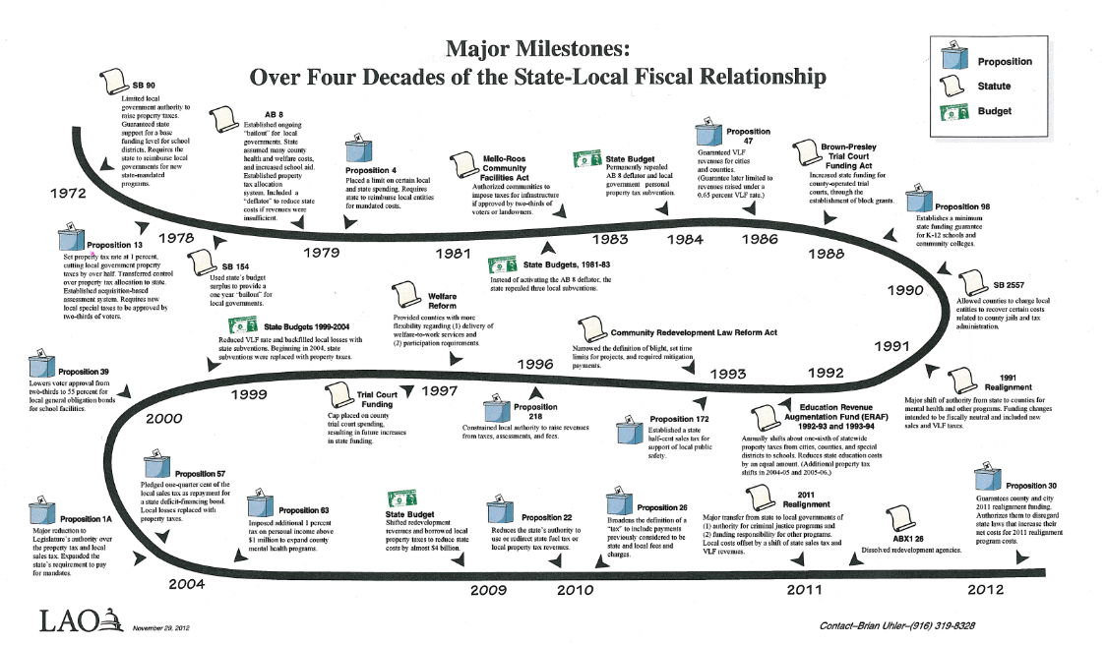
Effect of State Budget/ Local Impacts
34

Slide 35
Sample of Increase Service Delivery – last 10 years
Bought Vactor truck and began more aggressive sewer cleaning program.
Built new Development Services Building
Built new Public Works facility
Built new Animal Services facility
Increased household hazardous waste collection to every weekend
Renovated Town Hall

Slide 36
Sample of Increase Service Delivery – last 10 years
Widened Apple Valley Road and completed north extension of Apple Valley Road.
Widened Kiowa Road
Widened Dale Evans Parkway
Bought street sweeper and began street sweeping

Slide 37
Town of Apple Valley
37
Mid-Year Budget Status Report
Fiscal Year 2015-16
Questions?

