Slide 1

Town of Apple Valley
FISCAL YEAR 2018-2019 PROPOSED BUDGET
Budget Session
June 26, 2018

Slide 2

BUDGET SESSION
Agenda:
  Overview of Proposed FY18-19 Budget including Department/Program Highlights
  Questions/comments from Town Council

Slide 3
FY 18-19 BUDGET PROCESS
January
February
Finance
Analyze & Project
Revenue Estimates
Council provides input
to staff on Council’s
priorities for
FY18-19 Budget
January
BUDGET
KICK-OFF
January/February
February/March
Departments
Submit Budget
Requests to Finance
Finance analyzes
Budget Requests/Finalize
Revenue Projections/
Mid-Year Budget Review
March
April
April
Town Manager holds
Budget Hearings
with Departments
Proposed Capital
Improvement Program
Finalized
Finance Staff
Prepares Proposed Budget
April/May
June
June 26th
Council/Town Manager
Conduct Budget Workshop/
Town Manager and Finance
Prepares Final Proposed
Budget
Staff provides Council
Budget Update and
Balancing Measures
for Direction
Town Council
Holds Public Hearing
And Adopts Budget

Slide 4
Challenges Faced in Developing FY18-19 Proposed Budget
Baseline service levels have increased dramatically over the last 10 years.
Revenues are growing but still not keeping pace with expenditure increases.
  No new revenues to fund growth in services
  Coupled with annual inflationary increases in all other expenditures

Slide 5
Challenges Faced in Developing FY18-19 Proposed Budget
State and Federal Government Impacts.
Implementation of austerity measures.
No programs or services added without a source of funding to pay for the expansion in service delivery.

Slide 6
FY18-19 Proposed Operating and Capital Improvement Budget
Represents Management’s Recommended Budget to;
  Address Town Council’s priorities within
  Existing Financial Constraints to
  Fulfill the Service Requirements of the Community.

Slide 7
BUDGET SUMMARY
All Funds
FY 18-19 Estimated Revenues $ 87,345,382
Appropriations from Fund Balance 1,126,421
FY 18-19 Total Resources $ 88,471,803
FY 18-19 Appropriations $ 88,471,803
FY 18-19 Total Appropriations $ 88,471,803

Slide 8
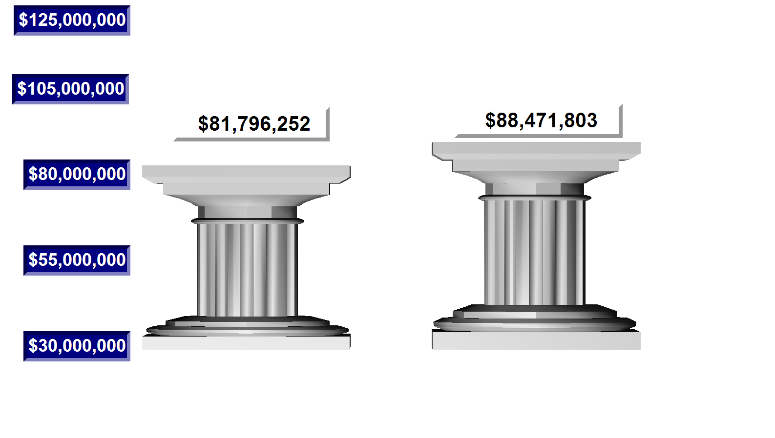
TOTAL APPROPRIATIONS
All Funds – Current v. Proposed
FY 17-18
Adopted
FY 18-19
Proposed

Slide 9
TOTAL OPERATING BUDGET
All Funds
Proposed FY 18-19 $ 68,416,321
Adopted FY 17-18 67,384,197
Amount of Increase $ 1,032,124
Percent Increase 1.53 %

Slide 10
TOTAL CAPITAL IMPROVEMENT BUDGET - All Funds
Proposed FY 18-19 $ 12,104,682
Adopted FY 17-18 6,035,333
Amount of Increase $ 6,069,349
Percent Increase 100.56 %

Slide 11
TOTAL APPROPRIATIONS
By Fund Type
Total $88,471,803

Slide 12
DISTRIBUTION OF SALARIES & BENEFITS
- All Funds
Total $ 9,275,732
County Sheriff - $13,776,796

Slide 13
GENERAL FUND SUMMARY
FY 18-19 Est. Revenues Administrative Overhead FY 18-19 Total Resources FY 18-19 Proposed Budget Balance | $ 28,271,491 3,255,400 $ 31,526,891 $ 31,526,891 $ -0-
Notes:
Refer to “Note 1” on page 5

Slide 14
SUMMARY OF APPROPRIATIONS
By Major Service Program – General Fund
Total $31,526,891

Slide 15
GENERAL FUND APPROPRIATIONS
FY 18-19 Proposed $ 31,526,891*
FY 17-18 Adopted 28,735,371
Amount of Increase $ 2,791,520
Percent Increase 9.70%
*Includes $3,010,481 for Parks & Recreation and $958,335 in Debt Service payment
Notes:
FY 13-14 P&R Transfer = $545,885, AVGC FY13-14 Transfer = $333,892

Slide 16
GENERAL FUND RESOURCES
Total $31,526,891

Slide 17
SALES & USE TAX
General Fund
FY 18-19 Estimated Revenue $ 6,284,500
FY 17-18 Estimated Revenue 6,151,000
Amount of Increase $ 133,500
Percent Increase 2.20%

Slide 18
SALES TAX COLLECTIONS
By Business Categories – CY 2017

Slide 19
SALES & USE TAX HISTORY
General Fund
Includes Sales Tax Backfill through 2015-16

Slide 20
PROPERTY TAX
General Fund
FY 18-19 Estimated Revenue $ 5,209,420*
FY 17-18 Estimated Revenue 3,480,300
Amount Increase $ 1,729,120
Percent Increase 49.70%
* Includes $1,640,000 Parks and Recreation

Slide 21
PROPERTY TAX HISTORY
General Fund – (Exc. Sales Tax Backfill and VLF Backfill)
Notes:
Slope line correspondingly follows recessionary line

Slide 22
PARKS AND RECREATION FUND SUMMARY
FY 18-19 Est. Revenues Subsidy FY 18-19 Total Resources FY 18-19 Proposed Budget | $ 2,706,516 303,965 $ 3,010,481 $ 3,010,481
22
Notes:
22
Refer to “Note 1” on page 5

Slide 23
AV GOLF COURSE FUND SUMMARY
FY 18-19 Est. Revenues Transfers In FY 18-19 Total Resources FY 18-19 Proposed Budget Appropriation to Net Assets | $ 615,500 450,000 $ 1,065,500 $ 1,064,666 834
Total Appropriations | 1,065,500
23
Notes:
23
Refer to “Note 1” on page 5

Slide 24
BUDGET SUMMARY
All Funds
FY 18-19 Estimated Revenues $ 87,345,382
Appropriations from Fund Balance 1,126,421
FY 18-19 Total Resources $ 88,471,803
FY 18-19 Appropriations $ 88,471,803
FY 18-19 Total Appropriations $ 88,471,803

Slide 25
BUDGET SUMMARY
All Funds (including transfers)
FY 18-19 Appropriations $ 88,471,803
FY 17-18 Appropriations $ 81,796,252
Total Increase $ 6,675,551
8.16%
25

Slide 26

Fiscal Year 2018-2019
Proposed Budget
CAPITAL IMPROVEMENT PROGRAM
HIGHLIGHTS
26
Notes:
26

Slide 27
TOTAL CAPITAL IMPROVEMENT BUDGET - All Funds
Proposed FY 18-19 $ 12,104,382
Adopted FY 17-18 6,035,333
Amount of Increase $ 6,069,349
Percent Decrease 100.56 %
27

Slide 28
Capital Improvement Projects
CIP Process
  CIP project reviews began in Fall 2017
  Identified existing projects in the current year that had remaining appropriations that could be returned to reserves
  Reviewed prioritization criteria and prioritized projects
  Reviewed current capacity - staff’s ability to start and complete projects as budgeted
  Staff meets to get input on the CIP Plan and discuss during departmental budget hearings

Slide 29
Capital Improvement Projects
Highlights of Projects Proposed for Funding in FY 18/19:
  27 Projects planned for design and construction
  Total CIP Budget for FY 18-19 - $12.1m

Slide 30
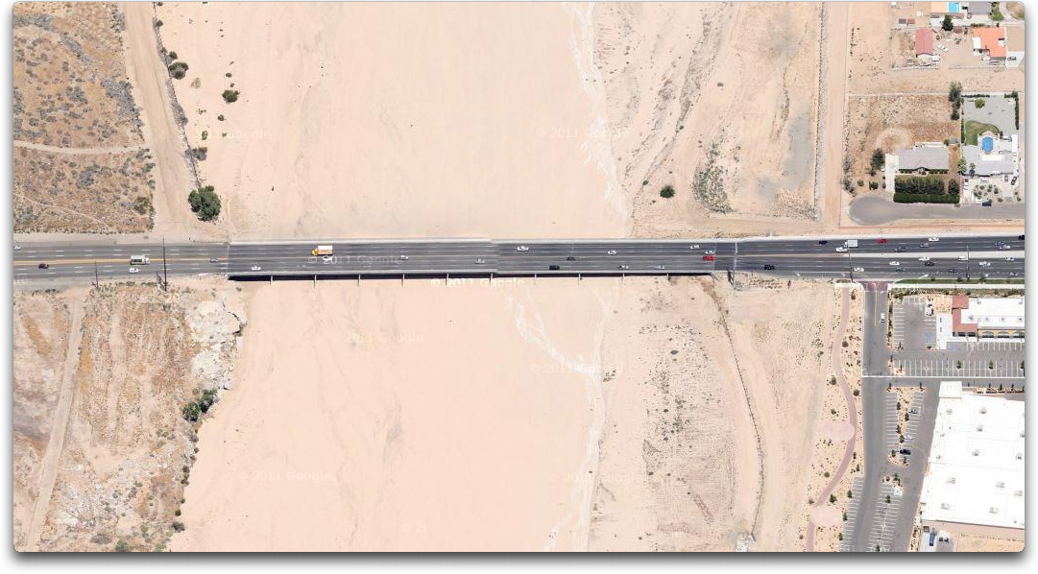
Capital Improvement Projects
Bear Valley Bridge Rehabilitation
  Full design work - $600k
  Will consist of six east/west travel lanes, center median, shoulders and class 1 bikeway.

Slide 31
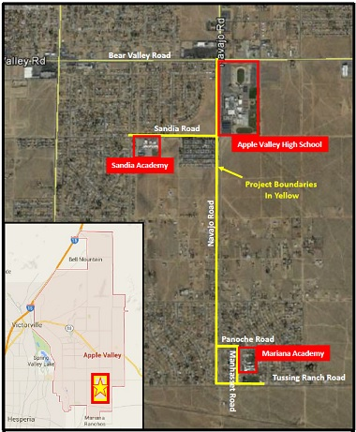
Capital Improvement Projects
Apple Valley South Safe Routes to School Navajo Road from Bear Valley Road South to Tussing Ranch Road, etc. - $2.81 million
  Design and construction of 5,390' of new sidewalk and replace 9,500' of pavement to create a Class 1 bike path, add curb and gutter; signage and striping; ADA ramps; and high visibility crosswalks.

Slide 32
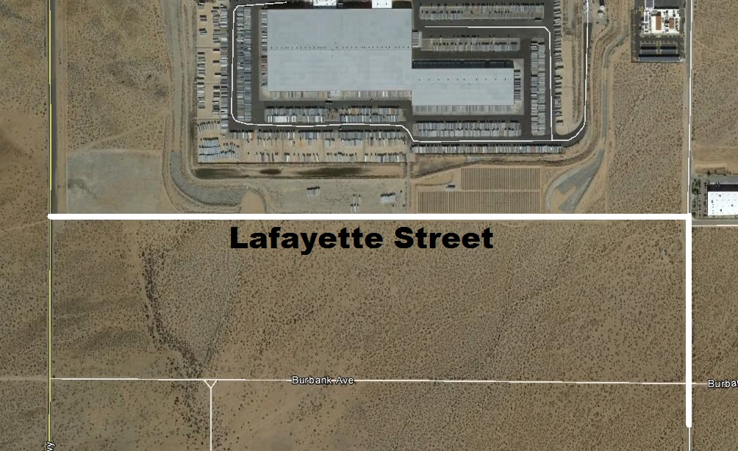
Capital Improvement Projects
Lafayette between Dale Evans and Navajo - $1.23 million
  Design and construction of regional street improvements.

Slide 33
Capital Improvement Projects
Apple Valley Desert Water Reuse Project - $1.373 million
  This project will provide one million gallons per day of clean, recycled water suitable for irrigation and groundwater recharge.

Slide 34
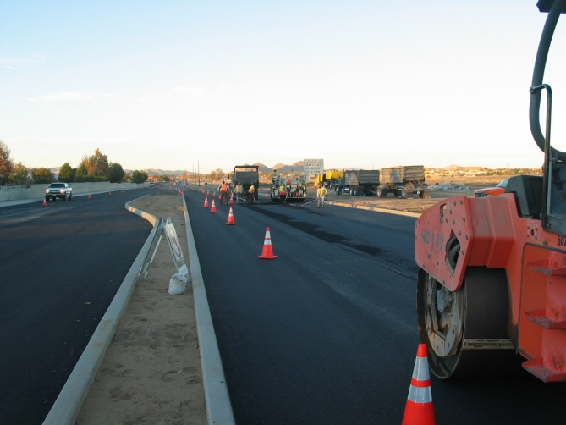
Capital Improvement Projects
  Town-wide Paving Priorities per PMS - $2.3 million

Slide 35
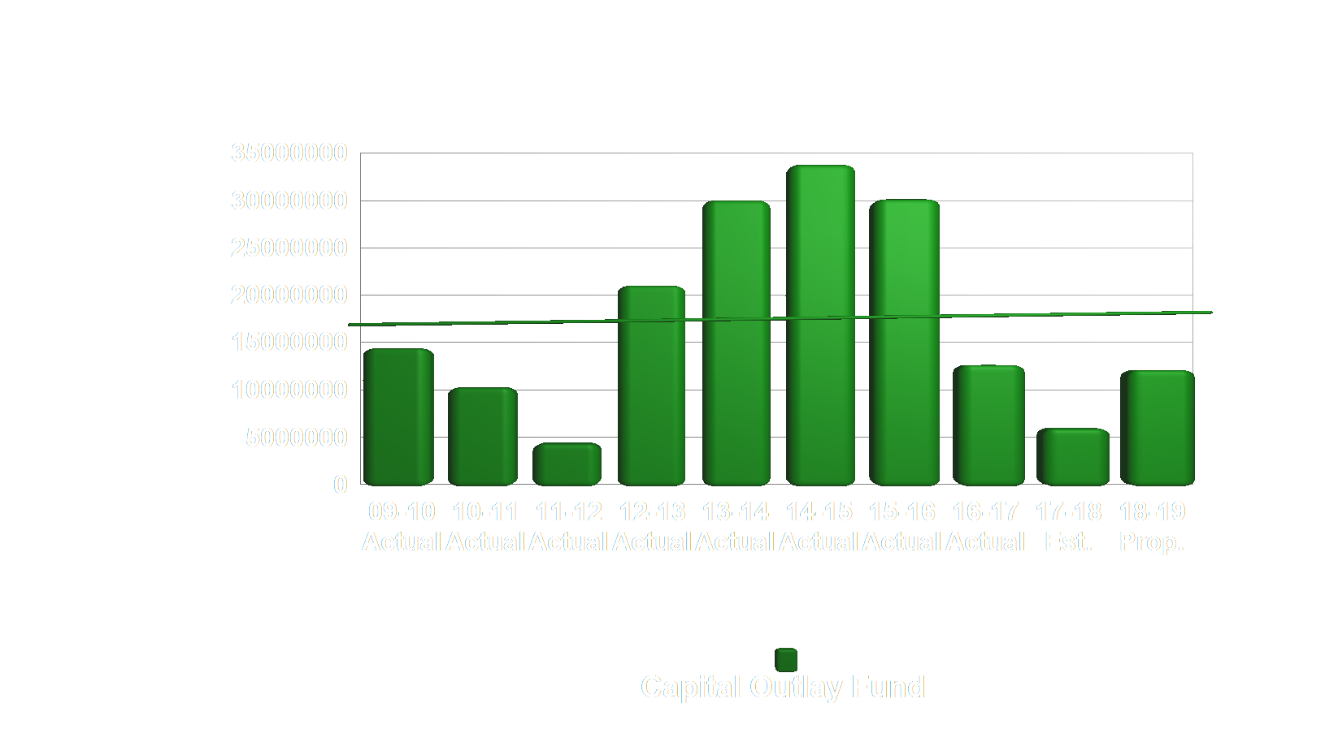
CIP FUNDING: Ten-Year Historical Comparison
35

Slide 36
Fiscal Year 2018-2019
Proposed Budget
DEPARTMENT/PROGRAM
HIGHLIGHTS
36
Notes:
36

Slide 37
Department/Program
Appropriations
Town Council
FY 18-19 Prop. Approp. $ 235,298
FY 17-18 Appropriations 232,127
Amount of Increase $ 3,171
Percent Increase 1.36%
Key changes: None

Slide 38
Department/Program
Appropriations
Town Manager
FY 18-19 Prop. Approp. $ 540,488
FY 17-18 Appropriations 625,310
Amount of Decrease $ (84,822)
Percent Decrease (13.56%)
Key changes: Decrease in employee benefit and contract service costs.

Slide 39
Department/Program
Appropriations
Town Clerk
FY 18-19 Prop. Approp. $ 413,859
FY 17-18 Appropriations 458,992
Amount of Decrease $ (45,133)
Percent Decrease (9.83%)
Key changes: Election costs budgeted, reduction in force, decrease in employee benefit costs

Slide 40
Department/Program
Appropriations
Finance
FY 18-19 Prop. Approp. $ 831,192
FY 17-18 Appropriations 1,140,968
Amount of Decrease $ (309,776)
Percent Decrease (27.15%)
Key changes: Reduction in force, decrease in employee benefit costs

Slide 41
Department/Program
Appropriations
Public Information
FY 18-19 Prop. Approp. $ 312,676
FY 17-18 Appropriations 521,113
Amount of Decrease $ (208,437)
Percent Decrease (40.0%)
Key changes: Functional reorganization, decrease in employee benefit costs

Slide 42
Department/Program
Appropriations
Human Resources
FY 18-19 Prop. Approp. $ 211,501
FY 17-18 Appropriations 433,841
Amount of Decrease $ (222,340)
Percent Decrease (51.25%)
Key changes: Reduction in force, decreased employee benefit costs

Slide 43
Department/Program
Appropriations
Public Safety
FY 18-19 Prop. Approp. $ 14,594,833
FY 17-18 Appropriations 13,753,922
Amount of Increase $ 840,911
Percent Increase 6.11%
Key changes: Increased County Sheriff contract and other costs

Slide 44
HISTORY – County Sheriff Contract: General Fund
44

Slide 45
County Sheriff Contract Costs:
General Fund
Public Safety
  51 total sworn officers
  $4 million increase over 8 years with no change in staffing
  Over $500,000 average increase annually
  COWcap increase not included in these numbers – currently $500k
Annual Increases of $500k are Not Sustainable Without Significant Change in Service Delivery or New Funding Source for Public Safety

Slide 46
DEPARTMENT/PROGRAM HIGHLIGHTS/GOALS
Public Safety
  Installed security camera surveillance system at the station
  Purchased a mobile Automated License Plate Reader
  Employed regular traffic saturation even which resulted in substantial reduction in traffic accidents
  2017 Crime Statistics indicate a 14% drop in crime in TOAV

Slide 47
Department/Program
Appropriations
Animal Shelter
FY 18-19 Prop. Approp. $ 2,001,229
FY 17-18 Appropriations 2,058,334
Amount of Decrease $ (57,105)
Percent Decrease (2.77%)
Key changes: Decrease in employee benefit costs and reorganization

Slide 48
Department/Program
Appropriations
Code Enforcement
FY 18-19 Prop. Approp. $ 816,237
FY 17-18 Appropriations 963,810
Amount of Decrease $ (147,573)
Percent Decrease (15.31%)
Key changes: Decreased employee benefit costs, change in staff allocations, direct labor grant funding

Slide 49
Department/Program
Appropriations
Public Works
FY 18-19 Prop. Approp. $ 21,200,895
FY 17-18 Appropriations 20,661,711
Amount of Increase $ 539,184
Percent Increase 2.61%
Key changes: Includes appropriations for Street Maintenance Fund, Wastewater (Sewer) Fund, Waste Management (Solid Waste) Fund. Annual contract cost increases for tipping fees, sewage treatment, decrease in employee benefits, retirement of long-term employee. Includes Apple Valley Desert Water Reuse project.

Slide 50
Department/Program
Appropriations
Parks and Recreation
FY 18-19 Prop. Approp. $ 3,010,481
FY 17-18 Appropriations 3,331,496
Amount of Decrease $ (321,015)
Percent Decrease (9.63%)
Key changes: Decreased employee benefit costs, closure of Virginia Park, reorganization

Slide 51
DEPARTMENT/PROGRAM HIGHLIGHTS
Parks and Recreation:
  Implemented a new recreation management software program (Etrak) and began offering online registration for customers. More than 25% of registrations in the first year have been done online
  Celebrated the 20th Anniversary of the Freedom Festival at the Lenny Brewster Sports Center with over 10,000 people in attendance
  Replaced the lighting in the Michael H. Martin Gymnasium, the mini-gym, James Woody Community Center and James Woody Park exterior lights with efficient high output LED lights as part of Southern California Edison’s OBF program.
  Completed a turf removal project at James Woody Park behind the Field # 3 outfield and installed a walking path, picnic tables and benches, providing a beautiful passive recreation area in the park.
  Partnered with the AVPAL program to offer the Town’s first Trunk or Treat event and had well over 1,000 people attend.

Slide 52
Department/Program
Appropriations
Community Development (Planning)
FY 18-19 Prop. Approp. $ 685,833
FY 17-18 Appropriations 801,996
Amount of Decrease $ (116,163)
Percent Decrease (14.48%)
Key changes: Decreased employee benefit costs, change in staff allocations, reduction in contract services cost

Slide 53
Department/Program
Appropriations
Economic Development
FY 18-19 Prop. Approp. $ 165,868
FY 17-18 Appropriations 108,325
Amount of Increase $ 57,543
Percent Increase 53.12%
Key changes: Reorganization-increased staff allocation, decreased employee benefit costs

Slide 54
Department/Program
Appropriations
Engineering Development
FY 18-19 Prop. Approp. $ 535,600
FY 17-18 Appropriations 360,600
Amount of Increase $ 175,000
Percent Increase 48.53%
Key changes: Current year budget reflects actual cost average for past four years

Slide 55
Fiscal Year 2018-2019
Proposed Budget
OTHER ISSUES
55
Notes:
55

Slide 56
State Transportation Bill – Road Maintenance and Rehabilitation Account (RMRA)
Adds $0.12 per gallon effective Nov. 1, 2017
Adds vehicle registration tax called the “Transportation Improvement Fee” effective January 1, 2018
Adds $100 vehicle registration tax on zero emission vehicles effective on July 1, 2020
Town received $421,813 in FY2017-18 and projected to receive $1,302,450 in FY 2018-19 under RMRA

Slide 57
CalPERS ROR Assumption Changes
18-19 | $113,704
19-20 | $119,355
20-21 | $123,595
57

Slide 58
CalPERS ROR Assumption Changes
FY Impact | Normal Cost | UAL Payments
2018-19 | $3.8 – 11.5k | $30.6 – 46k
2020-23 | $15.3 – 46k | $307 – 383k
58

Slide 59
Budget Balancing Measures
No COLA included in Proposed Budget for FY2018-19
Suspend 401a employee benefit for FY 2018-19
Closure of Virginia Park
Explore Other Funding sources for fund General Fund operations
Recommended for Adoption as part of Proposed Budget

Slide 60
FISCAL YEAR 2018-2019
PROPOSED BUDGET
Final bound copies – July 31, 2018
Copies available for Public Viewing at:
- Town Clerk’s Office at 14955 Dale Evans Parkway (Town Hall)
- Town’s Website: www.applevalley.org
Additional information contact 760-240-7000 x7704

Slide 61

Town of Apple Valley
FISCAL YEAR 2018-2019 PROPOSED BUDGET
June 26, 2018
Questions?

