Slide 1
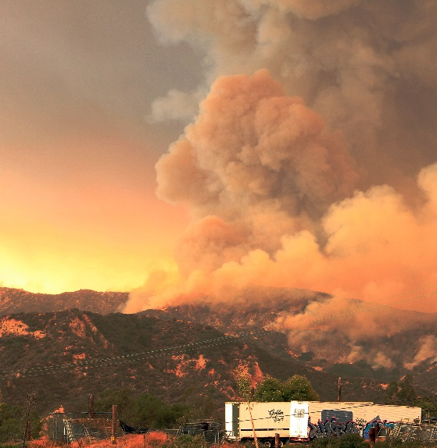
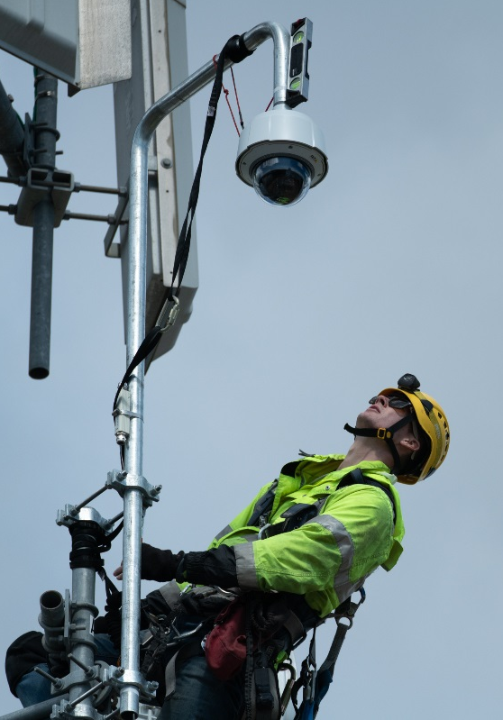
Wildfire Mitigation Plan

Slide 2
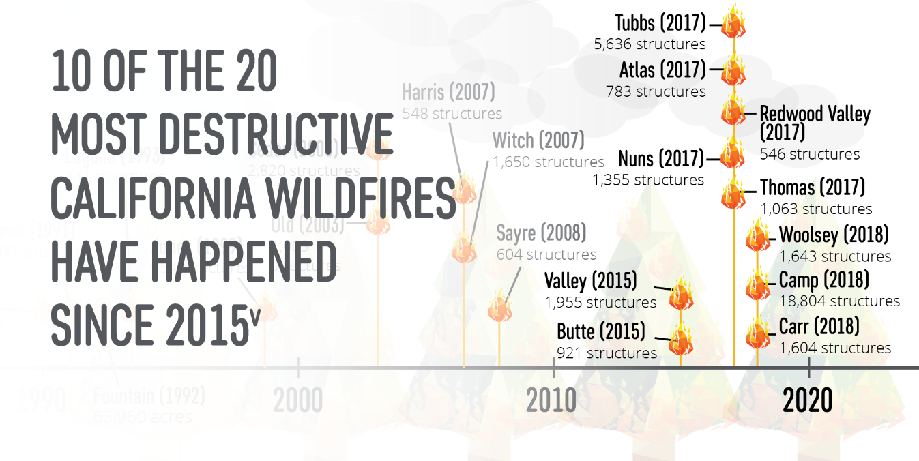
California’s Wildfire Risk
Year-Round Fire Season: Changes to California’s climate means that the traditional notion of a fire “season” no longer exists
Hazardous fuel is building up: 10M acres of land contain ready-to-burn kindling from nearly 147M trees that have been killed or weakened by drought and bark beetle infestation
Source: http://www.fire.ca.gov/communications/downloads/fact_sheets/Top20_Destruction.pdf

Slide 3

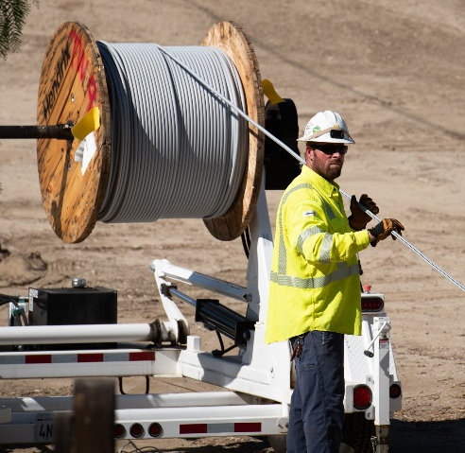
Objective of SCE’s Wildfire Mitigation Plan
Protect public safety
Implement the plan to reduce the risk of potential wildfire-causing ignitions associated with SCE’s electrical infrastructure
Implement measures that further harden SCE’s electric system against wildfires and improve system resiliency
Enhance wildfire suppression efforts by improving fire agencies’ ability to detect and respond to emerging fires in coordination with utility emergency management personnel
Effectively communicate with customers, community groups, and other stakeholders about how to prevent, prepare for, and mitigate the effects of wildfires

Slide 4
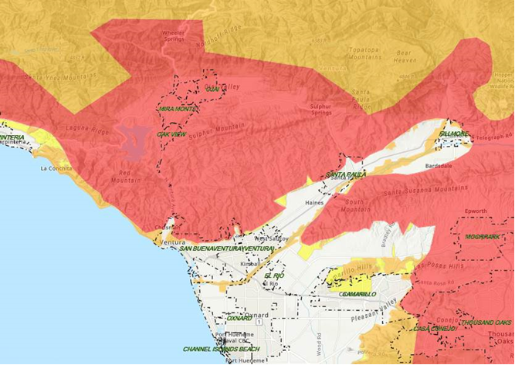
Local Community High Fire Risk Area Map
Approximately 1/3 of SCE’s 50,000 square mile service area is located in HFRA.
What makes up SCE’s HFRA?
A combination of historical map boundaries (based on past fire management and response experiences), CAL FIRE’s Fire Hazard Severity Zone (FHSZ) maps, and most recently the CPUC High Fire Threat District map are used to inform SCE’s High Fire Risk Areas.
Map will be customized for the meeting
CPUC Tier 3 = ~18%
CPUC Tier 2 = ~9%
Other HFRA = ~8%
* Areas within SCE’s service area that continue to be designated as HFRA and are in the process of being evaluated to determine whether they remain as HFRA

Slide 5
Scope of SCE’s 2019 SB 901
Wildfire Mitigation Plan
OPERATIONAL | Inspections | Enhanced overhead inspections (EOI) on transmission and distribution structures in HFRA Various existing inspections (poles, switches, circuits, relays, etc.) Infrared, Corona scanning and high definition (HD) imagery
 | Public Safety Power Shutoff (PSPS) | Effective communications and engagement with emergency services, customers and communities
 | Situational Awareness | Weather stations and HD cameras
 | Vegetation Management | Hazard tree removal (trees beyond traditional trim zone) Vegetation removal at poles LiDAR surveying for transmission, supplemental inspections in HFRA SCE plans to implement a 12-ft tree clearances from distribution power lines in high fire areas to ensure annual growth will not encroach on compliance distances.
INFRASTRUCTURE | Covered Conductor | Circuit miles of covered conductor in HFRA
 | Undergrounding | Evaluation of certain distribution lines in HFRA for potential undergrounding.
 | Other Infrastructure Mitigations | Various system hardening activities (e.g., composite poles, current limiting fuses (CLFs), remote automatic reclosers (RARs), Fast Curve settings) Studies, evaluations and pilots of alternative technologies
¹Per SCE’s Grid Safety & Resiliency Program (GSRP)

Slide 6
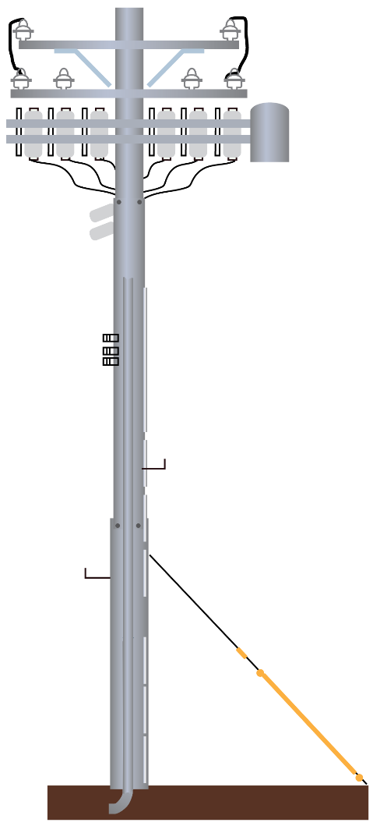
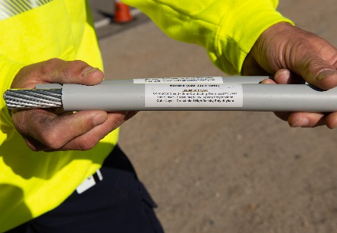

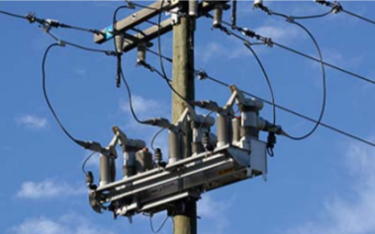
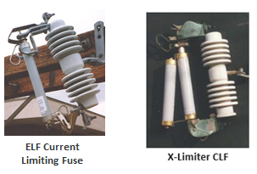
Infrastructure - System Hardening Elements
Hardened System
Covered Conductor
Fast-Acting, Current Limiting Fuses (CLF)
Reclosers

Slide 7
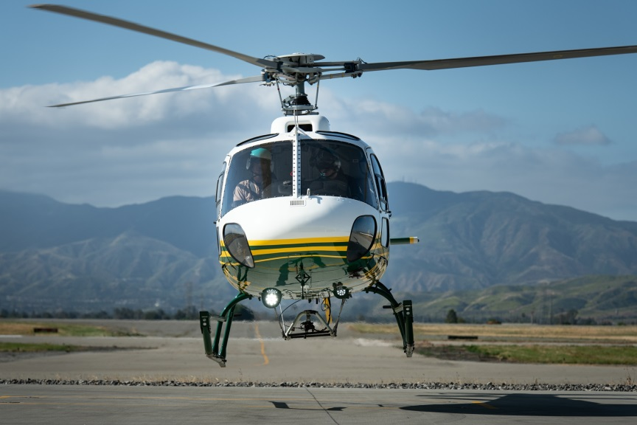
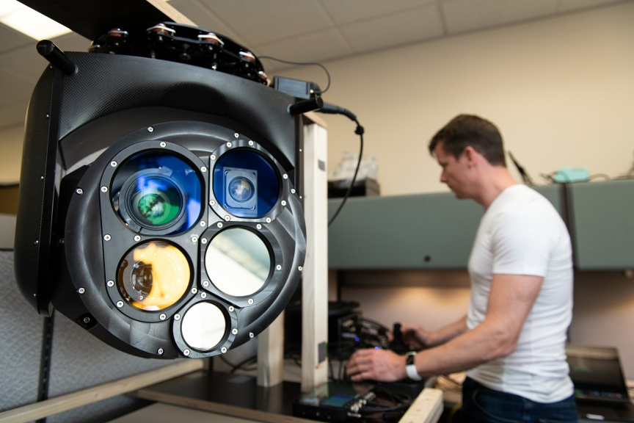
Enhanced Overhead Inspections (EOI)
Enhanced Overhead Inspections Identify Potential Risks
In less than 5 months, our crews completed detailed ground-based inspections of 400,000+ distribution and transmission structures in HFRA
Deploying helicopters and drones equipped with Infrared, Ultraviolet, LiDAR and HD image
scanning to perform aerial inspections of our facilities in HFRA
SCE’s helicopters are equipped with software and high-tech cameras, like the one shown above, to find potential risk undetectable to the human eye

Slide 8
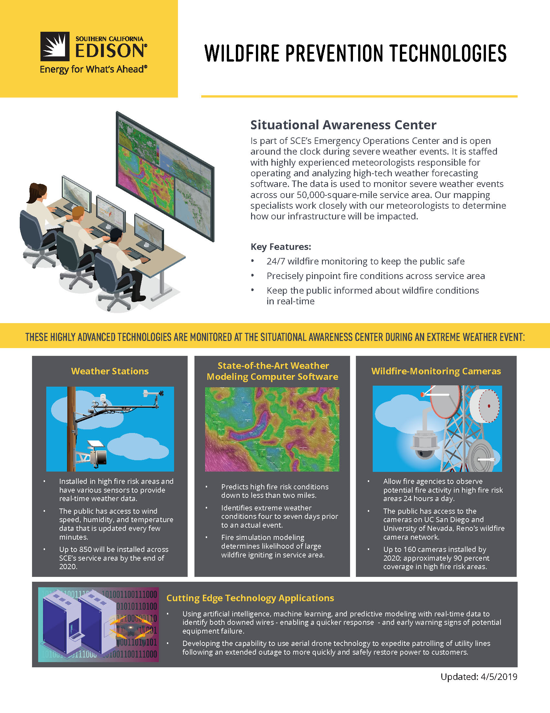
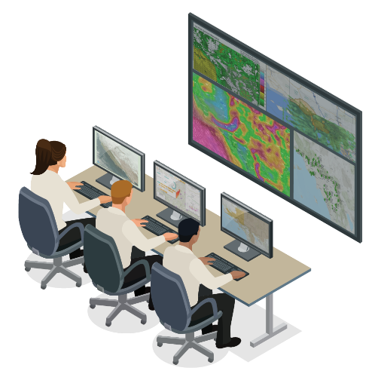
Situational Awareness Capabilities
Advanced Weather Modeling
Fire Monitoring Cameras
Weather Stations
Hi-Res Data
Local Weather
Better Forecasting
Advanced Warning
High-Definition
Remote-controlled
Situational Awareness Center
SCE meteorologists
24/7 monitoring

Slide 9
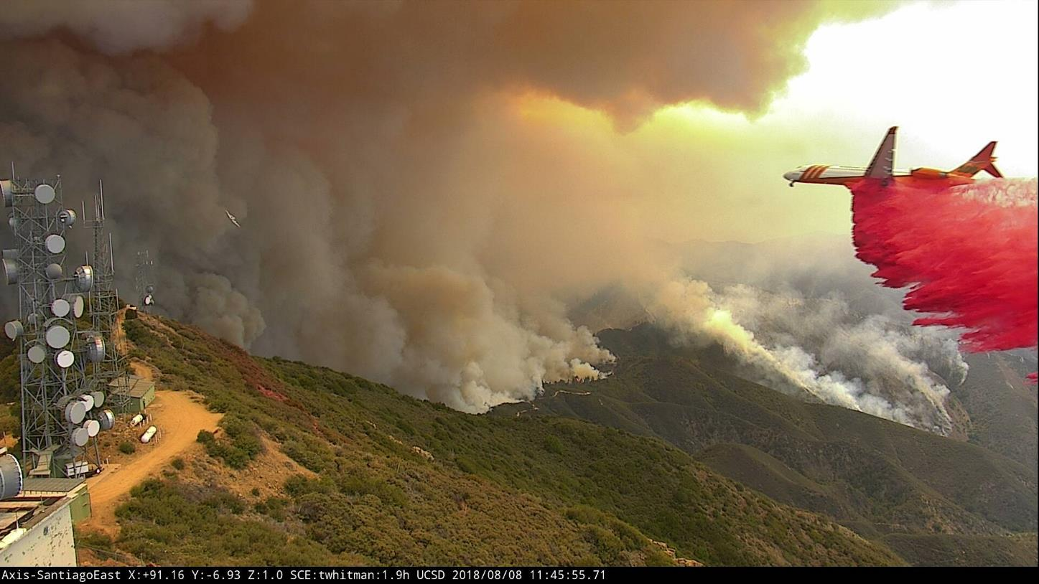
Wildfire HD Camera

Slide 10
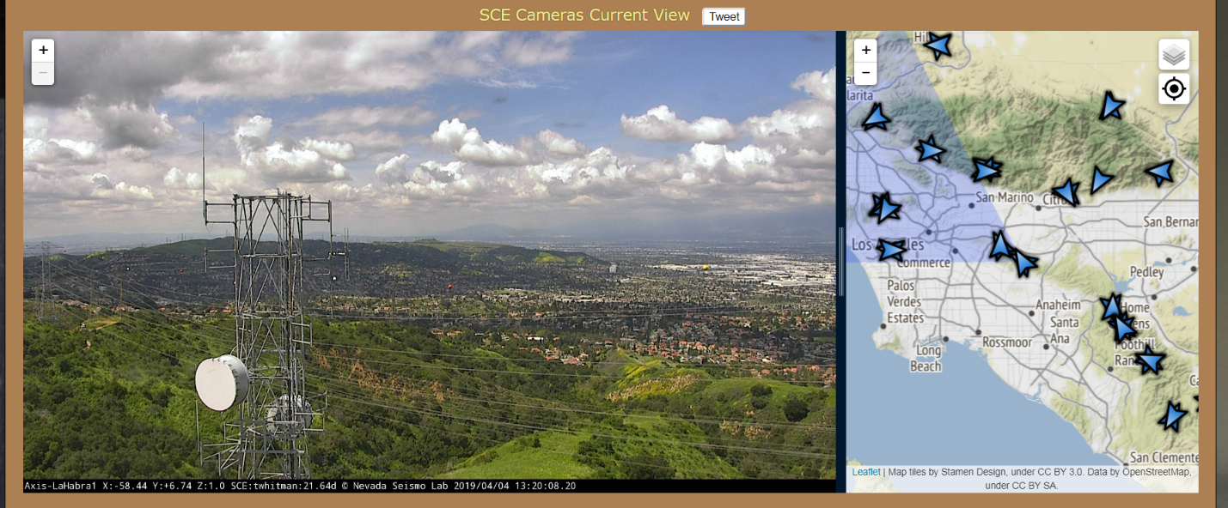
Wildfire HD Camera
www.alertwildfire.org

Slide 11
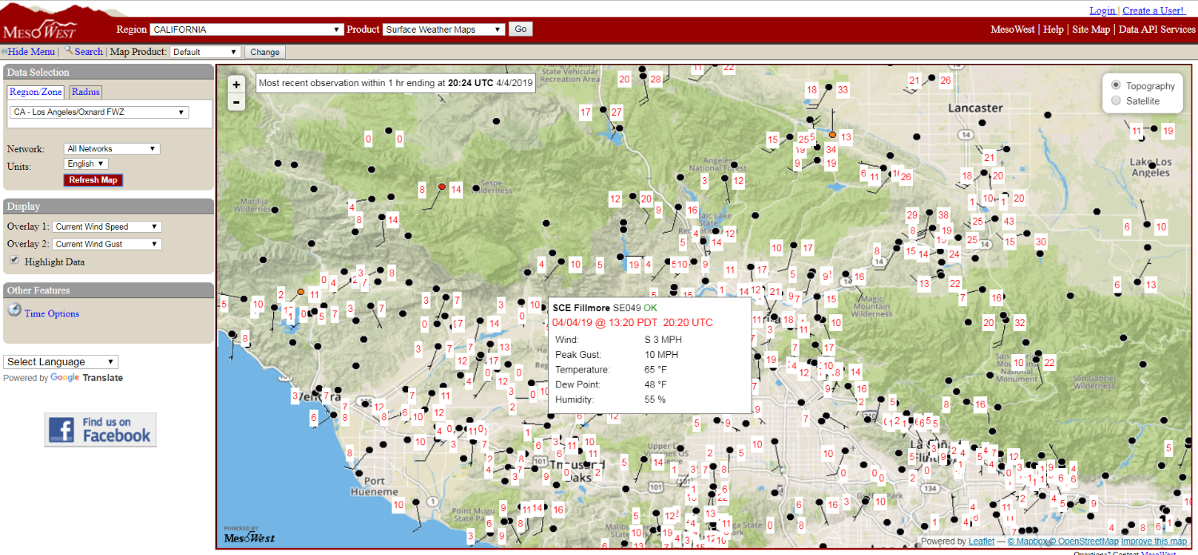
Weather Stations
mesowest.utah.edu

Slide 12
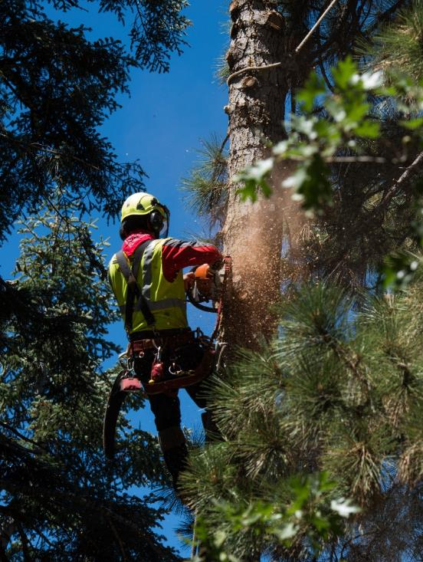
Vegetation Management
20+ in-house certified arborists
800+ pruning contractors with 60 more
crews added June/July 2018
≈ 900,000 trees inspected annually
≈ 700,000 pruned per year;
400,000 trees in high fire risk areas
2019
Continue to remove dead, dying, diseased trees in HFRA
Remove additional 7,500 which pose a fall-in or blow-in risk to SCE electrical facilities in HFRA
SCE has implemented a 12-ft tree clearance from distribution power lines in high fire areas to ensure annual growth will not encroach on compliance distances.

Slide 13
Public Safety Power Shutoff (PSPS)
  De-energization to prevent ignitions from powerlines
  Used during extreme fire conditions
  Primarily impacts circuits in high fire risk areas
    Other circuits in non-high fire risk areas may be impacted if transmission lines are de-energized
  Red Flag Warning does not mean a PSPS will be called
  Actual frequency of PSPS events will depend on various weather and environmental factors​
    Decision will be made with most accurate assessment of real-time information and situational awareness data

Slide 14
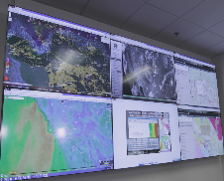
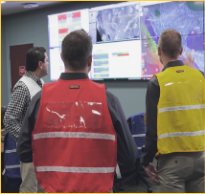
PSPS Ideal Timeline
4-7 DAYS AHEAD
3 DAYS
AHEAD
2 DAYS
AHEAD
1 DAY AHEAD
POWER SHUTOFF
POWER RESTORATION
Forecast Weather & Fire Conditions
SCE Incident Management Team activated
County Operational Areas informed of potential activation
1st Notification PSPS Possible sent to agencies and customers
2nd Notification PSPS
Possible
3rd Notification Power Shutoff
4th Notification Power Restored After Inspection
PLANNING AND MONITORING
OUTAGE
*Erratic or sudden onset of conditions may impact our ability to provide advanced notice to customers.

Slide 15

Community Resilience and Preparedness
Power Outages Can Occur for Many Reasons
  Maintenance
  Emergency Repairs
  Requests from Fire Agencies
  Natural Disasters
Have a Plan and Be Prepared
  Be Informed
  Plan Ahead
  Take Action

Slide 16
Useful Information
Update Customer Contact Information https://www.sce.com/outagealerts
Information on SCE Wildfire Mitigation Plan www.sce.com/wildfire
Twitter - @sce
Facebook – www.facebook.com/sce
Fire Cameras- www.alertwildfire.org
Weather Stations – mesowest.utah.edu
CPUC Wildfire Maps Information - www.cpuc.ca.gov/wildfiresinfo/
Fire Preparedness - calfire.ca.gov/fire_protection/fire_protection_be_prepared
Red Cross Emergency Preparedness
www.redcross.org/get-help/how-to-prepare-for-emergencies.html
FEMA Emergency Preparedness – www.ready.gov

Slide 17
Thank you

