Slide 1
Desert Region Workshop
PITC, HIC, PIT, Cost Study & More
Kent Paxton, Fifth District Homeless Policy Advisor
Tom Hernandez, Chief of Homeless Services
July 14, 2020
Notes:
This PowerPoint Template incorporates Master Slides—meaning that a master layout controls the look of the entire presentation. There are 4 master slide layouts—a title layout (shown here), a one column layout (slide 2), a two column layout (slide 3), and a 2 column layout with titles above (slide 4). When you insert a new slide, you are given these 4 “master layout” choices. To change the Department and Division titles, please see the instructions on slide 2.

Slide 2
Background
Cost Study Analysis
On May 27, 2020, Mr. Gregory Shinn of Creative Housing Solutions provided a written analysis and overview of the Cost Study Analysis of Chronic and Veteran Homeless Cohorts in San Bernardino County.
In the report Mr. Shinn reviewed the fiscal impacts and market demand for sustainable housing solutions.
As such, OHS and the Office of Fifth District Supervisor, Josie Gonzales are seeking feedback from each Regional Steering Committee on how we can use this data to direct future policy development within the county.

Slide 3
Cost Study Analysis Per Person Cost
Type of Encounter | Cost Per Person/Year
Outreach | $190.34
Incarceration | $1,304.78
Arrest/Adjudication | $2,987.55
Mental Health Treatment | $1,318.00
Substance Abuse Treatment | $34.00
Healthcare | $26,038.00
Total Cost | $31,872.67
Cost Per Year to Provide PH | Cost
Permanent Supportive Housing | $17,652.00
Rapid Re-Housing | $5,132.20

Slide 4
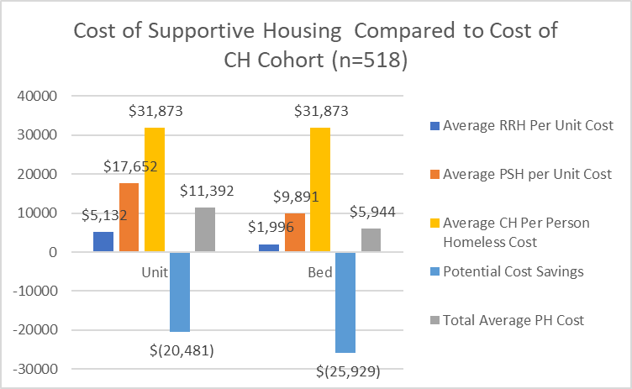
Cost of Permanent Housing Based on CH Analysis

Slide 5
Housing Inventory Count
Housing Type | Year-Round Beds
Emergency Shelter
Site-based | 181
Tenant-based | 302
 | 483
Permanent Supportive Housing
Site-based | 196
Tenant-based | 1,407
 | 1,603
Rapid Re-Housing
Tenant-based | 2,101
 | 2,101
Safe Haven
Site-based | 24
 | 24
Transitional Housing
Site-based | 133
Tenant-based | 53
 | 186
Total of 4,397 Beds

Slide 6
Number of Providers on the HIC
Provider Type | HIC Projects by Type
ES | 43
PSH | 19
RRH | 40
SH | 1
TH | 12
Grand Total | 115

Slide 7
Desert Region City Data

Slide 8
City of Adelanto
Gender | Number | Percent
Male | 7 | 70.0%
Female | 3 | 30.0%
Adelanto Details: 11 Counted; 10 Surveys Administered
Total Chronically Homeless: 3 (30.0%)
Average Cost to Leave on Street: $95,618.01
Average Cost to Permanently House: $52,956.00
Cost Savings Per Year: $42,662.01

Slide 9
Town of Apple Valley
Gender | Number | Percent
Male | 14 | 70.0%
Female | 6 | 30.0%
Apple Valley Details: 24 Counted; 20 Survey Administered
Total Chronically Homeless: 8 (40.0%)
Average Cost to Leave on Street: $254,981.36
Average Cost to Permanently House: $141,216.00
Cost Savings Per Year: $113,765.36

Slide 10
City of Barstow
Gender | Number | Percent
Male | 30 | 66.7%
Female | 15 | 33.3%
Barstow Details: 78 Counted; 45 Surveys Administered
Total Chronically Homeless: 19 (42.2%)
Average Cost to Leave on Street: $605,580.73
Average Cost to Permanently House: $335,388.00
Cost Savings Per Year: $270,192.73

Slide 11
City of Hesperia
Gender | Number | Percent
Male | 4 | 80.0%
Female | 1 | 20.0%
Hesperia Details: 19 Counted; 5 Surveys Administered
Total Chronically Homeless: 1 (20.0%)
Average Cost to Leave on Street: $31,872.67
Average Cost to Permanently House: $17,652.00
Cost Savings Per Year: $14,220.67

Slide 12
City of Victorville
Gender | Number | Percent
Male | 124 | 65.3%
Female | 66 | 34.7%
Victorville Details: 298 Counted; 190 Surveys Administered
Total Chronically Homeless: 70 (36.8%)
Average Cost to Leave on Street: $2,231,086.90
Average Cost to Permanently House: $1,235,640.00
Cost Savings Per Year: $995,446.90

Slide 13
Desert Region
Gender | Number | Percent
Male | 179 | 66.7%
Female | 91 | 33.3%
Desert Details: 430 Counted; 270 Surveys Administered
Total Chronically Homeless: 101 (37.4%)
Average Cost to Leave on Street: $3,219,139.67
Average Cost to Permanently House: $1,782,852.00
Cost Savings Per Year: $1,436,287.67
Just based on the cost savings that equates to 81 units that can be created for PSH or 280 RRH families served

