Slide 1
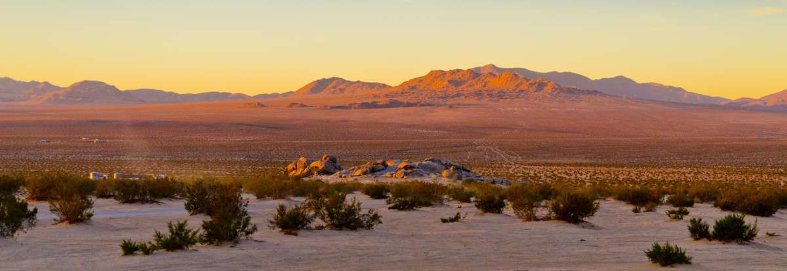
Mid-Year Budget Review 20-21

Slide 2
2020-2021 Mid-Year Budget Review
Were the Targets Achieved?
20-21 Year End Projections
Where will we end up at year end?
Finance Health Check
How do we stay on task to increase reserves?
20-21 Revenues Y-T-D
20-21 Expenditures Y-T-D
How do we compare today?

Slide 3
2020-2021 Mid-Year Budget Review
Mid-Year Budget Status Staff Report
Budget Adjustment Number 2021-13 including budget adjustments - all funds
Exhibit A - Mid Year Budget Adjustment Summary
Exhibit B - Budget Comparison by Fund/Department/Division
General Fund Revenue Projections
Projected Fund Balances – June 30, 2021
FY 2019-20 Project Carry-forwards
AGENDA

Slide 4
General fund 2019-20 Year end vs. 2020-21 adopted budget
2019-20 year end
2020-21 adopted budget
Actual Revenues | $ 30,649,390
Transfers In | 3,788,417
Approp. From Fund Balance | 454,903
Total Resources | 34,892,710
Actual Expense | $ 34,892,710
Balance | -0-
Estimated Revenues | $ 28,815,647
Transfers In | 3,641,560
Approp. From Fund Balance | 3,525,857
Total Resources | 35,983,064
Adopted Budget | $ 35,983,064
Balance | -0-
Notes:
Amended 19-20 Exp Budget was $36,397,199. Underspent by $1,504,489

Slide 5
revenues

Slide 6
2020-21 Revenues
Adopted Revised
Property Tax $ 3,344,000 $ 3,344,000
Property Tax Parks & Recreation 1,984,000 1,984,000
Property Tax – VLF Backfill 7,655,000 7,655,000
Sales & Use Tax 5,900,000 7,644,339
Franchise Tax 2,119,000 2,119,000
Other Local Tax 1,233,200 1,163,200
Public Safety Fines and Fees 262,000 262,000
Public Services 1,600,079 1,674,552
Building and Safety 1,077,250 1,077,250
Planning Fees 173,700 173,700
Engineering 90,000 90,000
Parks & Recreation 1,008,725 354,900
Other Revenues 6,010,253 7,482,006
Total General Fund Revenues $ 32,457,207 $ 35,023,947
Notes:
With Transfer in. Other local tax decrease of pass thru residual RPTTF = $70k. P&R COVID Closures. Other Rev = Emer Prep Grant/CARES Act, restitution, rentals, misc reimbursements, gains on sale, etc. GF Revenue increase of $2,672,450!

Slide 7
Revenue by category 2020-21

Slide 8
PROPERTY TAX *Includes park & Recreation

Slide 9
SALES TAX

Slide 10
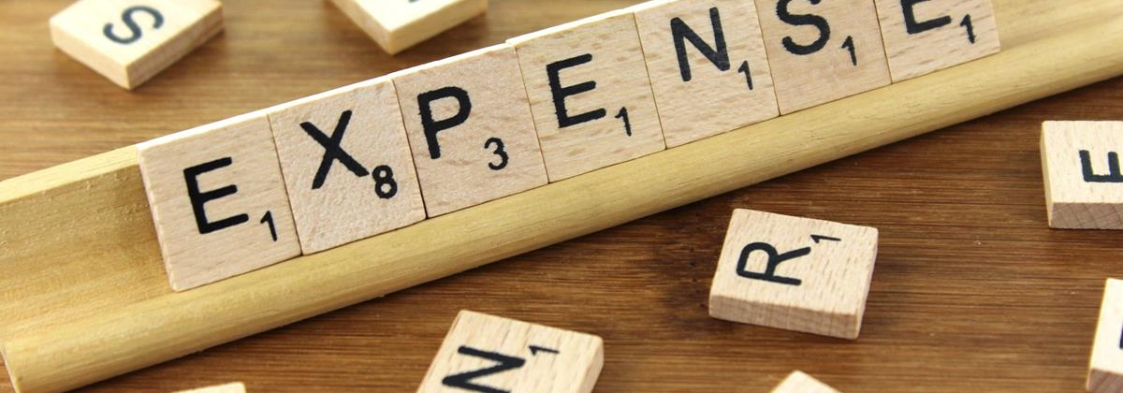
expenditures

Slide 11
2020-21 expenditures
2020-21 Adopted Budget
Estimated Revenues | $ 28,815,647
Transfers In | 3,641,560
Approp. From Fund Balance | 3,525,857
Total Resources | 35,983,064
Adopted Budget | $ 35,983,064
Balance | -0-
Estimated Revenues | $ 28,815,647
Proposed Rev. Adjustments | 2,672,450
Transfers In | 3,535,850
Approp. From Fund Balance | 1,565,041
Total Resources | $ 36,588,988
Amended Budget | $ 35,986,394
Prop. Approp. Adjustments | 602,594
Total Adj. Appropriations | $ 36,588,988
Balance | -0-
2020-21 Revised Budget
Notes:
Includes Amendments for CARES project spending offset with a decrease of P&R Program cancellations.

Slide 12
Expenditure by category 2020-21

Slide 13
Safety

Slide 14
Revenue & Expenditure history

Slide 15
General fund Projection to year end

Slide 16
Carry forward
CARRY FOWARD FOR CIP |  | 2019-2020 |  |  |  | 2020-2021
 |  | Budget | Estimate | Actual | Carryover | Adopted | Amended
Measure I
AV Safe Routes to School | 2021-5210-9265 | 2,897,000 | 2,897,000 | 827,182 | 2,069,818 | - | 2,069,818
Tuscola/Kasota Connection | 2021-5210-9566 | 220,000 | 215,000 | 212,664 | 7,336 | - | 7,336
 |  |  |  |  | 2,077,154 |  | 2,077,154
PO Number | Vendor | Project | GL Code | Amount
1314-000039 | Dokken Engineering | BVR Bridge Condition Analysis | 2021-5210-9282 | 296,104.59
1819-000045 | Willdan | Cost Study for Dev. of MSHCP | 1001-4610-8940 | 787.50
1920-000033 | California Truck Equipment Co. | Installation of animal body on ford f-350 trucks | 1001-1200-9140 | 16,000.00
1920-000035 | Dokken Engineering | SR18 AV RD design | 2021-5210-9410 | 190,017.00
1920-000038 | Parsons Transportation Group | SR18 AV RD construction management | 2021-5210-9410 | 6,038.46
1920-000039 | CXT Precast Products, Inc. | Restroom building to be installed | 2120-4210-7430-0805 | 85,630.00
OPEN PURCHASE ORDER CARRY FOWARD |  |  | Grand Total | 594,577.55

Slide 17
Finance health check
Building Reserves
To pay for one-time, nonrecurring expenses that will build capacity, such as staff development or research and development
Creates a fail safe for cash flows and fiscal flexibility
Saves financing small, one-time purchases and avoids additional interest payments
Intercepts inflating costs and paydown with discounts

