Slide 1
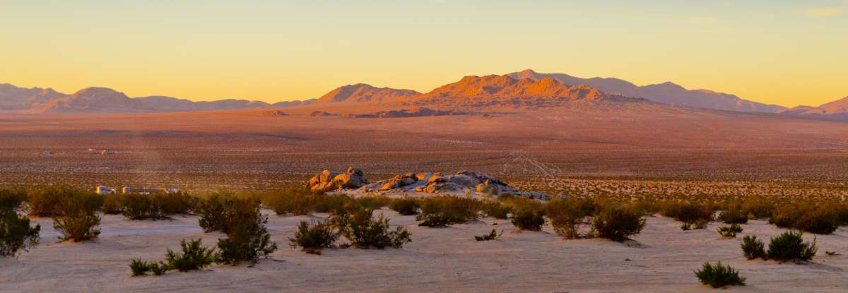
Budget Workshop 21-22

Slide 2
Budget workshop agenda
Overview of Proposed 21-22 Budget
Proposed Adopted Budget – Over All Funds
General Fund
Expenditure & Revenue Highlights
Capital Improvement Projects
Possible Revenue Increases and Expenditure Reductions
Timeline for 21-22 Budget Adoption
Questions/Comments
Summary Overall
Other Funds Budget Comparison

Slide 3
Budget Summary of all funds
2020-2021Adopted Budget
2021-2022 Proposed budget
Estimated Revenues | $ 91,376,863
Appropriation from Fund Balance | 4,611,878
Total Resources | $ 95,988,741
Proposed Appropriations | $ 98,199,970
Non-Cash Transactions | (2,211,229)
Total Spending | $ 95,988,741
Estimated Revenues | $ 95,546,463
Appropriation from Fund Balance | 3,681,134
Total Resources | $ 99,227,597
Proposed Appropriations | $ 101,371,265
Non-Cash Transactions | (2,143,668)
Total Spending | $ 99,227,597
Notes:
Amended 19-20 Exp Budget was $36,397,199. Underspent by $1,504,489

Slide 4
Fiscal year 2021-2022 overview of proposed appropriations
PROPOSED BUDGET – ALL FUNDS
Appropriations | Proposed | Adopted | Increase (Decrease)
ALL FUNDS | FY 21-22 | FY 20-21 | Amount | Percent
Operating Budget | $80,974,404 | $82,054,815 | ($1,080,411) | -1.32%
Transfers Out | 4,204,900 | 4,111,560 | 93,340 | 2.27%
Capital Budget | 16,191,961 | 12,033,595 | 4,158,366 | 34.56%
Total | $101,371,265 | $98,199,970 | $3,171,295 | 3.23%

Slide 5
OVERVIEW OF PROPOSED BUDGET
OPERATING BUDGET BY EXPENDITURE CATEGORY- ALL FUNDS
 |  | Proposed |  | Amended |  | Increase (Decrease) |  |  |  | % of
 |  | FY 21-22 |  | FY 20-21 |  | Amount |  | Percent |  | Total
Salaries/Benefits |  | $11,532,726 |  | $10,708,554 |  | ($350,905) |  | -3.28% |  | 10.22%
General Operating |  | 5,439,822 |  | 4,913,658 |  | $526,164 |  | 10.71% |  | 5.37%
Community Dev |  | 7,161,238 |  | 4,623,574 |  | $2,537,664 |  | 54.89% |  | 7.06%
Building Maint |  | 231,450 |  | 208,185 |  | $23,265 |  | 11.18% |  | 0.23%
Grounds Maint |  | 254,200 |  | 191,100 |  | $63,100 |  | 33.02% |  | 0.25%
PIO Events |  | 319,578 |  | 287,663 |  | $31,915 |  | 11.09% |  | 0.32%
Public Works |  | 3,708,650 |  | 4,137,450 |  | ($428,800) |  | -10.36% |  | 3.66%
Culture/Recreation |  | 220,912 |  | 72,620 |  | $148,292 |  | 204.20% |  | 0.22%
Contract & Prof |  | 46,977,167 |  | 47,759,520 |  | ($782,353) |  | -1.64% |  | 46.34%
Vehicle & Equip |  | 1,016,275 |  | 985,355 |  | $30,920 |  | 3.14% |  | 1.00%
Depreciation |  | 2,143,668 |  | 2,143,668 |  | $0 |  | 0.00% |  | 2.11%
Debt Service |  | 2,762,795 |  | 4,411,990 |  | ($1,649,195) |  | -37.38% |  | 2.73%
Capital Outlay |  | 381,000 |  | 1,559,162 |  | ($1,178,162) |  | -75.56% |  | 0.38%
Capital Projects |  | 16,191,961 |  | 15,028,470 |  | $1,163,491 |  | 7.74% |  | 15.97%
Transfers Out |  | 4,204,900 |  | 4,005,850 |  | $199,050 |  | 4.97% |  | 4.15%
Total |  | $101,371,265 |  | $101,036,819 |  | $1,929,516 |  | 1.9% |  | 100.00%

Slide 6
OVERVIEW OF PROPOSED BUDGET
OPERATING BUDGET BY FUND TYPE- ALL FUNDS
 |  | Proposed |  | Amended |  | Increase (Decrease) |  |  |  | % of
 |  | FY 21-22 |  | FY 20-21 |  | Amount |  | Percent |  | Total
General Fund |  | $36,237,669 |  | $35,057,083 |  | $1,180,586 |  | 3.37% |  | 35.75%
Special Revenue Funds |  | 9,935,000 |  | 7,114,646 |  | $2,820,354 |  | 39.64% |  | 9.80%
Debt Service Funds |  | 232,706 |  | 0 |  | $232,706 |  | 0.00% |  | 0.23%
Capital Projects Funds (Operating) |  | 403,840 |  | 1,065,000 |  | ($661,160) |  | -62.08% |  | 0.40%
Proprietary Funds |  | 32,365,177 |  | 33,715,589 |  | ($1,350,412) |  | -4.01% |  | 31.93%
Trust Funds |  | 1,355,012 |  | 3,339,117 |  | ($1,984,105) |  | -59.42% |  | 1.34%
Agency Funds |  | 445,000 |  | 687,706 |  | ($242,706) |  | -35.29% |  | 0.44%
Total Operating Budget All Funds |  | 80,974,404 |  | 80,979,141 |  | ($4,737) |  | -0.01% |  | 79.88%
Capital Projects |  | 16,191,961 |  | 13,214,979 |  | $2,976,982 |  | 22.53% |  | 15.97%
Transfers Out |  | 4,204,900 |  | 4,005,850 |  | $199,050 |  | 4.97% |  | 4.15%
Grand Total All Funds |  | $101,371,265 |  | $98,199,970 |  | $3,171,295 |  | 3.23% |  | 100%

Slide 7
General Fund Highlights
Expenditures
Revenues

Slide 8
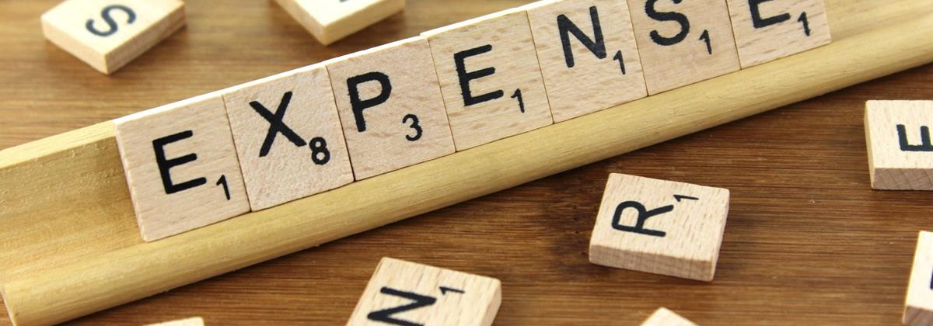
expenditures

Slide 9
Fiscal year 2021-2022 general fund summary
Estimated Revenues |  |  | $ 29,854,598
Transfers In:
Administrative Overhead |  | 2,484,900
Franchise Fees |  | 1,250,000 | 3,734,900
Total Resources |  |  | $ 33,589,498
Operating Expenditures |  |  | $ 36,636,349
Transfers Out to:
Golf Course Fund |  | 470,000 | 470,000
Total Proposed Appropriations |  |  | $ 37,106,349
Estimated Expenditures Exceed Proposed Revenues |  |  | $ 3,516,851

Slide 10
General Fund Expenditures By Category/Department
Category/Department | Proposed Budget | Category/Department | Proposed Budget
General Government |  | Public & Municipal Services
Town Council | $ 255,072 | Public Facilities | $ 688,236
Town Attorney | 320,000 | Animal Services | 727,923
Town Manager | 626,104 | Animal Shelter | 1,464,682
Finance | 1,217,172 | Code Enforcement | 537,581
Town Clerk | 562,099 | Building & Safety | 676,214
Public Information | 468,446 | Parks & Rec Grounds | 1,573,035
Human Resources | 185,926 | Parks & Rec Aquatic Center | 647,524
Information Systems | 1,339,280 | Parks & Rec Programs | 1,102,376
General Government | 5,295,508 | Parks & Rec Administration | 142,000
Total General Government | $ 10,269,607 | Total Public & Municipal Services | $ 7,559,571
Community & Economic Development |  | Public Safety
Economic Development | $ 263,577 | Police Services | $ 16,959,363
Engineering | 737,600 | Emergency Preparedness | 25,600
Planning-Community Development | 821,031 | Total Public Safety | $ 16,984,963
Total Community & Economic Development | $ 1,822,208 | Total Operating Expenditures | $ 36,636,349
 |  | Transfer to Golf Course Fund | $ 470,000
 |  | Total General Fund Appropriations | $ 37,106,349

Slide 11
General fund budget comparison
 |  |  | FY 20/21 |  | FY 21/22 | Increase
 | Department |  | Original | Amended | Proposed | (Decrease)
General Fund
 | Town Council | Town Council | 219,917 | 223,917 | 255,072 | 14%
 | Town Attorney | Town Attorney | 400,000 | 300,000 | 320,000 | 7%
 | Town Manager | Town Manager | 628,162 | 629,162 | 626,104 | 0%
 | Finance | Finance | 1,186,382 | 1,186,382 | 1,217,172 | 3%
 | Town Clerk | Town Clerk | 598,753 | 598,753 | 562,099 | -6%
 | Public Information | Public Information | 480,876 | 480,876 | 468,446 | -3%
 | Human Resources | Human Resources | 169,420 | 170,110 | 185,926 | 9%
 | Information Systems | Information Systems | 964,091 | 1,023,341 | 1,339,280 | 31%
 | General Government | General Government | 4,631,758 | 4,664,158 | 5,765,508 | 24%
 | Public Facilities | Public Facilities | 1,674,564 | 1,704,299 | 688,236 | -60%
 | Public Safety Police | Public Safety Police | 16,310,988 | 16,317,988 | 16,959,363 | 4%
 | Emergency Preparedness | Emergency Preparedness | 5,100 | 710,805 | 25,600 | -96%
 | Animal Control Services | Animal Control Services | 2,180,556 | 2,180,556 | 2,192,605 | 1%
 | Code Enforcement | Code Enforcement | 583,532 | 583,532 | 537,581 | -8%
 | Building & Safety | Building & Safety | 676,214 | 676,214 | 676,214 | 0%
 | Engineering Services | Engineering Services | 737,600 | 737,600 | 737,600 | 0%
 | Planning Services | Planning Services | 893,849 | 894,637 | 821,031 | -8%
 | Economic Development | Economic Development | 259,673 | 259,673 | 263,577 | 2%
 | Parks & Recreation | Parks & Recreation | 3,384,959 | 3,263,773 | 3,464,935 | 6%
Subtotal |  |  | 35,986,394 | 36,605,776 | 37,106,349 | 1%

Slide 12
Expenditure by category 2021-22

Slide 13
Safety

Slide 14
Fiscal year 2021-2022 park & rec summary
Estimated Revenues
Program Revenues | 1,019,130
Property Tax | 2,155,600 | $ 3,174,730
Appropriation from General Fund |  | 290,205
Total Resources |  | $ 3,464,935
Proposed Expenses |  | $ 3,464,935

Slide 15
Fiscal year 2021-2022 golf course fund summary
Estimated Revenues |  | $ 685,000
Transfer from General Fund |  | 470,000
Total Resources |  | $ 1,155,000
Proposed Expenses |  | $ 1,149,689
Less Depreciation |  | (115,000)
Adjusted Proposed Expenses |  | $ 1,034,689

Slide 16
Golf course service level

Slide 17
revenues

Slide 18
2021-22 general fund Revenues
Proposed
Property Tax $ 4,527,600
Property Tax Parks & Recreation 2,155,600
Property Tax – VLF Backfill 7,500,000
Sales & Use Tax 7,713,000
Franchise Tax 3,250,000
Other Local Tax 1,299,798
Public Safety Fines and Fees 446,500
Public Services 1,603,159
Building and Safety 1,009,650
Planning Fees 170,500
Engineering 65,000
Parks & Recreation 1,019,130
Other Revenues 2,829,561
Total General Fund Revenues $ 33,589,498
Notes:
With Transfer in. Other local tax decrease of pass thru residual RPTTF = $70k. P&R COVID Closures. Other Rev = Emer Prep Grant/CARES Act, restitution, rentals, misc reimbursements, gains on sale, etc. GF Revenue increase of $2,672,450!

Slide 19
Revenue by category 2021-22

Slide 20
PROPERTY TAX *Includes park & Recreation

Slide 21
SALES TAX

Slide 22
Revenue & Expenditure history

Slide 23
Capital improvement highlights

Slide 24
FISCAL YEAR 2021-2022 CAPITAL IMPROVEMENT BUDGET – ALL FUNDS
Proposed Budget 21-22 | $ 16,191,961
Amended Budget 20-21 | 14,452,909
Increase | $ 1,739,052
Percent Increase | 12.03%

Slide 25
Town of Apple Valley
Capital Improvement Plan
FY 2021-2022 Budget by Funding Source
 | Totals
Preliminary Design
High Desert Corridor | 2,500
Full Design
Bear Valley Bridge (Mojave River Bridge) | 400,000
Central Road from Highway 18 to Bear Valley Road | 200,000
Dale Evans Parkway @ Waalew Road (Realignment) | 25,000
Town Wide School Zone Analysis/LRSP | 50,000
Wika Road West End @ SR 18 Access Improvements (Phase 1) | 30,000
Construction
Apple Valley Village Accessibility Phase 2 | 672,000
Bear Valley Bridge (Mojave River Bridge) | 250,000
Central Road from Highway 18 to Bear Valley Road | 410,000
Hwy 18 West End Widening (Phase 1, AVR Realignment) | 4,940,000
Navajo Road Drainage Improvements | 10,000
Paving Priorities (50% Categorical/50% Non-Categorical) | 4,325,191
Reata Intersection Improvements | 452,270
Stoddard Wells Road Widening | 2,325,000
Town Wide School Zone Analysis/LRSP | 50,000
Sidewalk Repairs, Various Locations | 100,000
Street Maintenance Total | 14,241,961

Slide 26
Town of Apple Valley
Capital Improvement Plan
FY 2021-2022 Budget by Funding Source
 | Totals
Grounds Maintenance
James Woody Parking Lot Paving | 50,000
 | -
Grounds Maintenance Total | 50,000
Wastewater
Jess Ranch Lift Station and Sewer Modifications | 1,050,000
Replace Cleanouts with Manholes, Jess Ranch Community | 300,000
Sewer Main Extension/Housing Element | 250,000
Sewer Main/Manhole Replacement, Various Locations | 100,000
Sewer Manhole Cover Replacement, Assess. Dist. 2A (Year 3 of 7) | 100,000
Sewer Manhole Replacement, Bear Valley Road | 100,000
Wastewater Total | 1,900,000
Capital Projects Total | 16,191,961

Slide 27
Other funds budget comparison
 |  | FY 20/21 |  | FY 21/22 | Increase
 | Department | Original | Amended | Proposed | (Decrease) | Revenue
Other Funds
 | Street Maint Fund (Gas Tax) | 1,729,403 | 1,623,693 | 1,643,730 | 1% | 1,837,415
 | SB1 Road Maint Rehab | 1,262,600 | 1,262,600 | 5,534,691 | 338% | 3,645,331
 | Article 3 | 335,392 | 335,392 | - | -100% | -
 | Local Transportation | 531,103 | 531,103 | 436,000 | -18% | 439,965
 | Measure I | 8,029,250 | 10,598,564 | 6,212,875 | -41% | 5,981,750
 | CDBG | 1,453,605 | 1,539,235 | 1,541,730 | 0% | 1,541,730
 | NSP 3 | 281,000 | 281,000 | 285,000 | 1% | 285,000
 | Apple Valley Home | 1,648,504 | 1,648,504 | 3,944,871 | 139% | 3,944,871
 | Victorville Home | 1,483,989 | 1,483,989 | 1,483,989 | 0% | 1,483,989
 | Cal Home | 80,000 | 80,000 | 80,000 | 0% | 80,000
 | PEG Channel Fund | 448,500 | 448,500 | 93,500 | -79% | 120,000
 | MSHCP/NCCP | - | - | 150,000 | 0% | 300,000
 | Quimby | - | 173,456 | 540,000 | 211% | 310,000
 | Police Grants | 20,782 | 20,782 | - | -100% | 23,774
 | Assessment District LL | 333,400 | 333,400 | 220,000 | -34% | 320,000
 | PBID | 530,000 | 530,000 | 781,000 | 47% | 556,000

Slide 28
 |  | FY 20/21 |  | FY 21/22 | Increase
 | Department | Original | Amended | Proposed | (Decrease) | Revenue
 | NAVISP | - | - | - | 0% | 8,000
 | Capital Improvement TIF Fund | 825,250 | 825,250 | 1,671,895 | 103% | 575,000
 | Animal Control Facilities | - | - | - | 0% | 7,200
 | Law Enforcement Facilities | - | - | - | 0% | 15,500
 | General Government Facilities | - | - | - | 0% | 40,000
 | Public Meeting Facilities | - | - | - | 0% | 27,500
 | Aquatic Facilities | - | - | - | 0% | 9,200
 | Storm Drains | 940,000 | 940,000 | 10,000 | -99% | 140,000
 | Sanitary Sewer Facilities | - | - | - | 0% | 122,000
 | Project Manager Grants | - | 7,550 | 47,840 | 534% | 47,840
 | Wastewater Fund | 8,274,451 | 8,274,451 | 8,505,308 | 3% | 7,985,000
 | Waste Management Fund | 13,803,345 | 13,803,345 | 12,782,271 | -7% | 12,899,000
 | Apple Valley Golf Course | 1,166,233 | 1,166,233 | 1,149,689 | -1% | 1,155,000
 | Apple Valley Choice Energy | 15,464,946 | 15,464,946 | 15,562,809 | 1% | 16,451,000
 | Debt Service Funds | 232,706 | 232,706 | 232,706 | 0% | 240,000
 | Successor Agency RDA | 3,339,117 | 3,339,117 | 1,355,012 | -59% | 1,364,900
Subtotal |  | 62,213,576 | 64,943,816 | 64,264,916 |  | 61,956,965

Slide 29
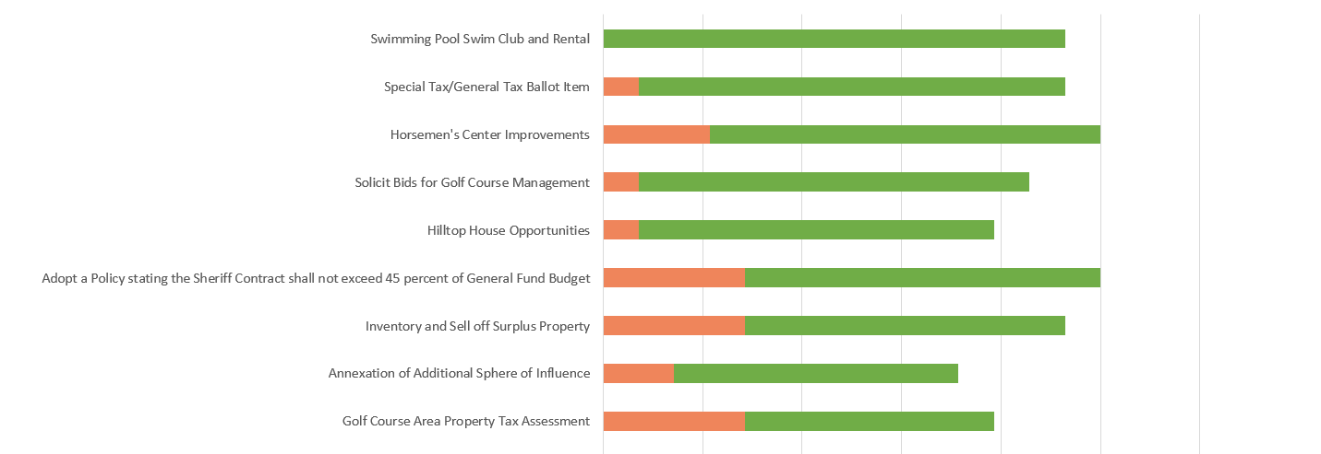
Possible revenue increases….

Slide 30
Timeline to 21-22 budget adoption
5/25/2021 - Council Recommendations
01
6/8/2021 – Possible Council & Mgmt Revisions
02
6/22/2021 – Budget Adoption
03

Slide 31
Questions/Comments

