Slide 1
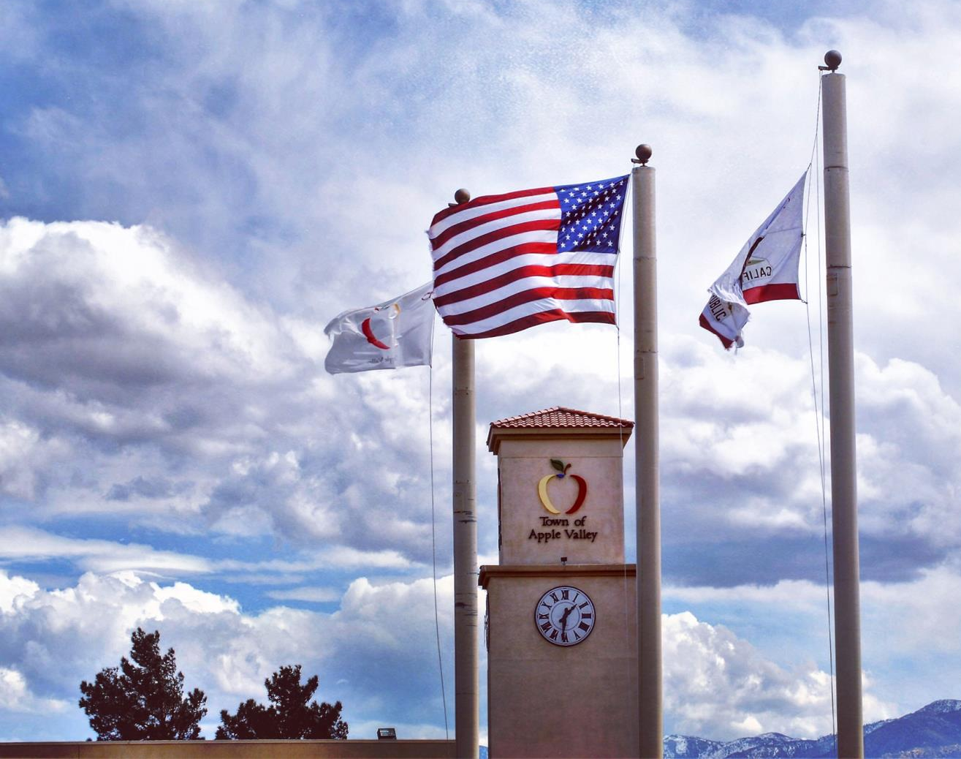



Mid-Year Budget Review 2021-22

Slide 2

FY 2021-22 Mid-Year Review Table of Contents
FY 2021-22 General Fund Revenues and Projections
FY 2021-22 General Fund Expenditure Update
American Rescue Plan Act (ARPA)
Revenue V. Expenditure Outlook
All Other Funds Review and Highlights
Looking Forward
Major General Fund Revenues By The Numbers

Slide 3



Slide 4

FY 2021-22 General Fund Revenue Updates
Sales and Use tax revenue projected to increase $1.4 million over original budget per review by HdL Companies.
Increased price of goods and full implementation of online sales and use tax collection major factors of current trend.
Building and inspection Permit revenues projected to increase combined total $615,000 due to current building activity.

Slide 5
Major General Fund Revenue By The Numbers

Slide 6


Slide 7
FY 2021-22 General Fund Expenditure Updates
Increased costs to material, labor for repairing aging equipment such as HVAC units.
Increase to utility rates.
Increased cost of repairs for vandalism.
Public Safety MOU increase of 5% annual plus inflationary factors.
Cut or reduced expenditure forecasts for Recreational programs under-performing or not being held this fiscal year.
Implementation of updated Enterprise Resource Planning (ERP).

Slide 8
American Rescue Plan Act (ARPA)
One-time funding source provided by emergency stimulus bill due to COVID-19.
Town to receive two distributions of $7,441,989.
First distribution received and able to reimburse $1,447,252 of qualifying expenditures back to FY 2020-21.
Remaining $5,994,736 to be recognized with FY 2021-22.
Second tranche still expected, and staff is closely monitoring release of distribution dates.

Slide 9
Revenue V. Expenditure Outlook
Limited revenue streams creates small pool of resources.
Expenditures increases out of Town’s control- Ex. Utilities and Inflation.
Resource allocation dedicated to meet Town’s priorities.
Reserve Funding.

Slide 10
All Other Funds Review and Highlights:
Lighting and Landscape Fund 2810- Updated needs for tree replacement, fencing, removal of dead brush, and irrigation update.
Wastewater Fund 5010 and Solid Waste Fund 5510- Increased utility adjustments that were previously unbudgeted.
Golf Course Fund 5710- Consolidating Building Maintenance Accounts for better budget tracking.
Animal Control seeking to utilize previously received grant (Fund 4910) money to support community spay and neuter program.

Slide 11
Looking Forward:
ARPA funds still to be received. One time funding opportunity.
Continued annual increase to Sheriff contract to maintain service levels.
Inflation impact to other contract services.
Inflation impact to labor and materials.
Potential revenue streams.
Prioritizing reserve building.

