Slide 1
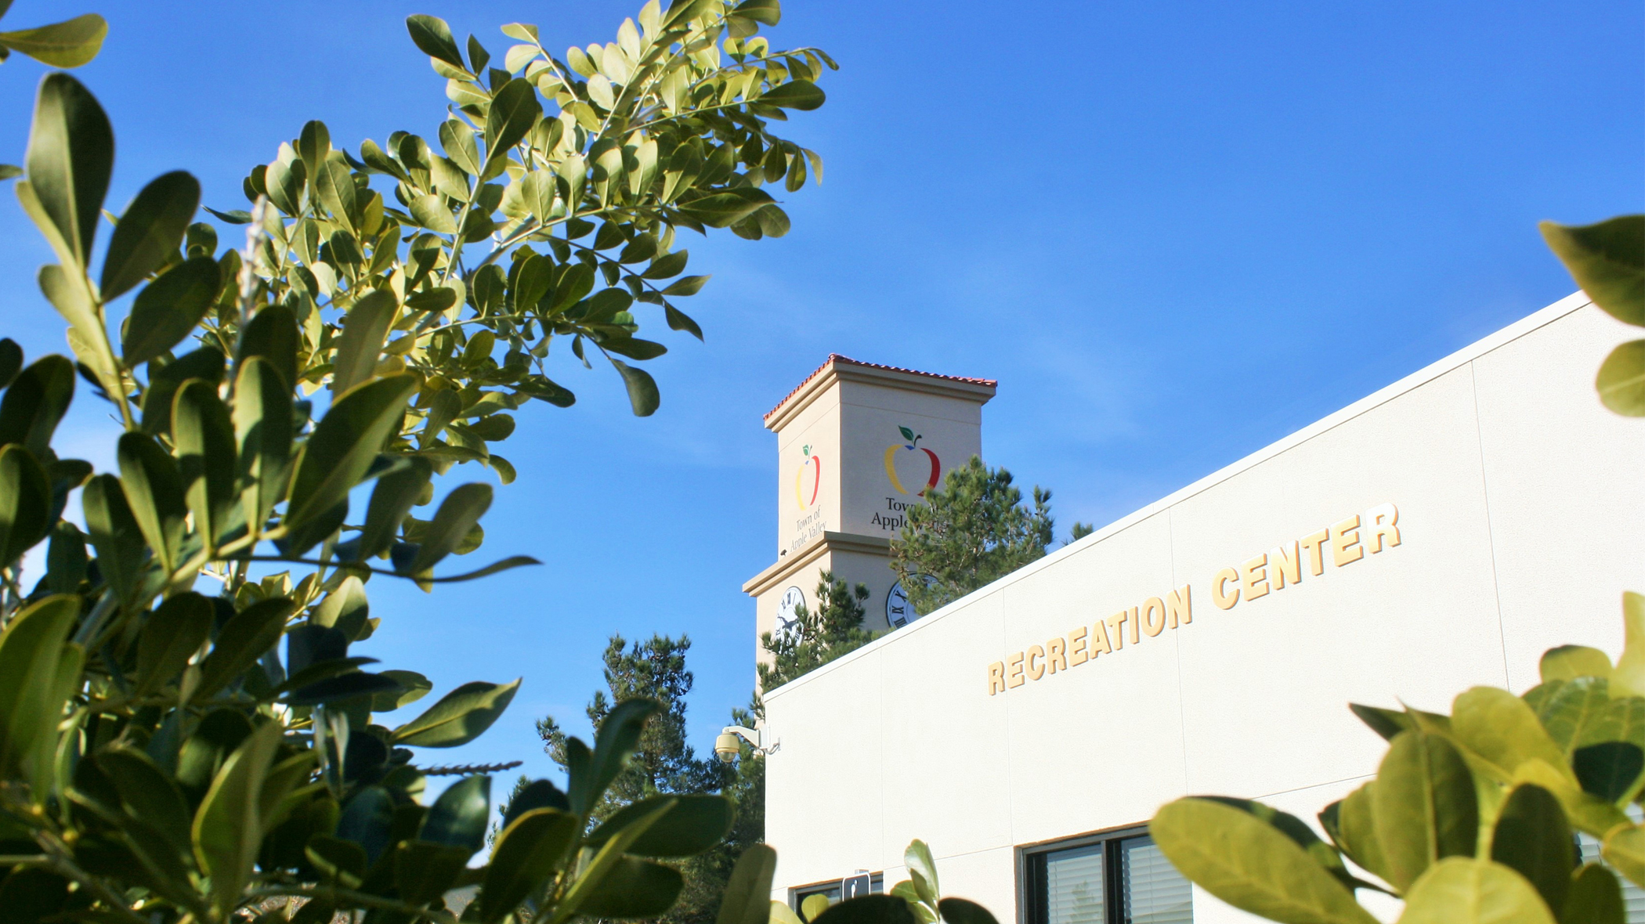
Town of Apple Valley
Fiscal Year 2022/23 Budget Workshop

Slide 2
Workshop Outline
Proposed Adopted Budget- Over All Funds
Budget Summary of All Funds
Personnel Overview
General Fund Highlights- Summary, Expenditures and Revenues
Capital Improvement Projects
Other Funds Budget Comparison
Forward Thinking
Questions/Comments

Slide 3
Proposed Adopted Budget Over All Funds
FY21-22 Amended Budget
Est. Revenues $92,806,441
Appropriation from
Fund Balance 6,486,560
Total Resources $99,293,001
Expenditure Appropriation $99,293,001
Total Spending $99,293,001
FY22-23 Requested Budget
Est. Revenues $88,094,690
Appropriation from
Fund Balance 13,738,072
Total Resources $101,832,762
Expenditure Appropriation $101,832,762
Total Spending $101,832,762

Slide 4
Budget Summary of All Funds
FY21-22 Amended Budget
General Fund
Revenue 35,857,984
Expenditure 39,402,538
Special Revenue Funds
Revenue 18,746,457
Expenditure 20,930,188
Enterprise Funds
Revenue 38,202,000
Expenditure 38,960,275
Total
Revenue 92,806,441
Expenditure 99,293,001
FY22-23 Requested Budget
General Fund
Revenue 37,349,761
Expenditure 39,772,571
Special Revenue Funds
Revenue 13,246,929
Expenditure 18,288,713
Enterprise Funds
Revenue 37,498,000
Expenditure 43,771,478
Total
Revenue 88,094,690
Expenditure 101,832,762

Slide 5
Personnel Overview
Fiscal Year 2022/23 total personnel cost under current salary range: $13,729,743
Fiscal Year 2022/23 total personnel cost with 2.5% COLA adjustment: $13,988,325
Difference $258,581

Slide 6
General Fund Highlights
Summary
expenditures
Revenues

Slide 7
General Fund Summary

Slide 8
General Fund Summary Including ARPA

Slide 10
Expenditures by Category/Department

Slide 11
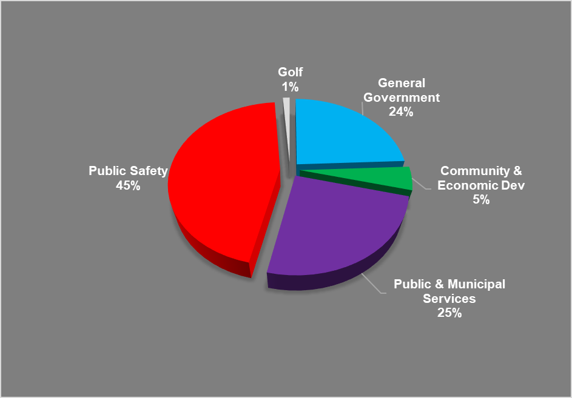
Expenditure by Category 2022/23

Slide 12
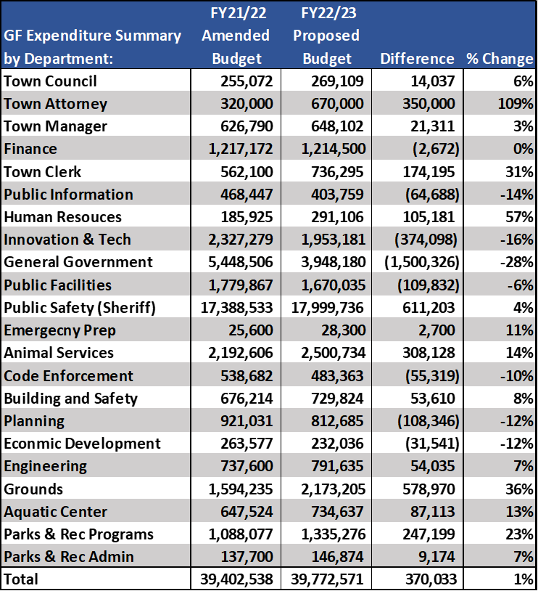
General Fund Budget Comparison

Slide 13
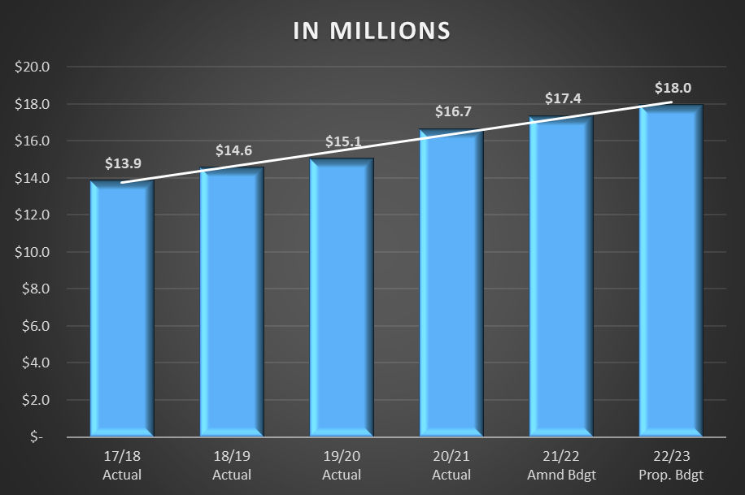
Review of Public Safety Costs
$4,000,000 increase since FY17/18
Services paid through General Fund

Slide 14
Parks and Recreation Summary
Park & Recreation
Estimated Revenues
Program Revenue | 1,027,475
Property Tax | 3,239,535
Appropiration from General Fund | 122,982
Total Resources | 4,389,992
Proposed Expenditures | 4,389,992

Slide 15
General Fund Revenues

Slide 16
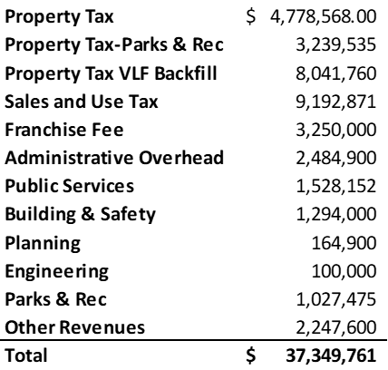
General Fund Revenues by Category

Slide 18
Property Tax Review

Slide 19
Sales Tax Review

Slide 20
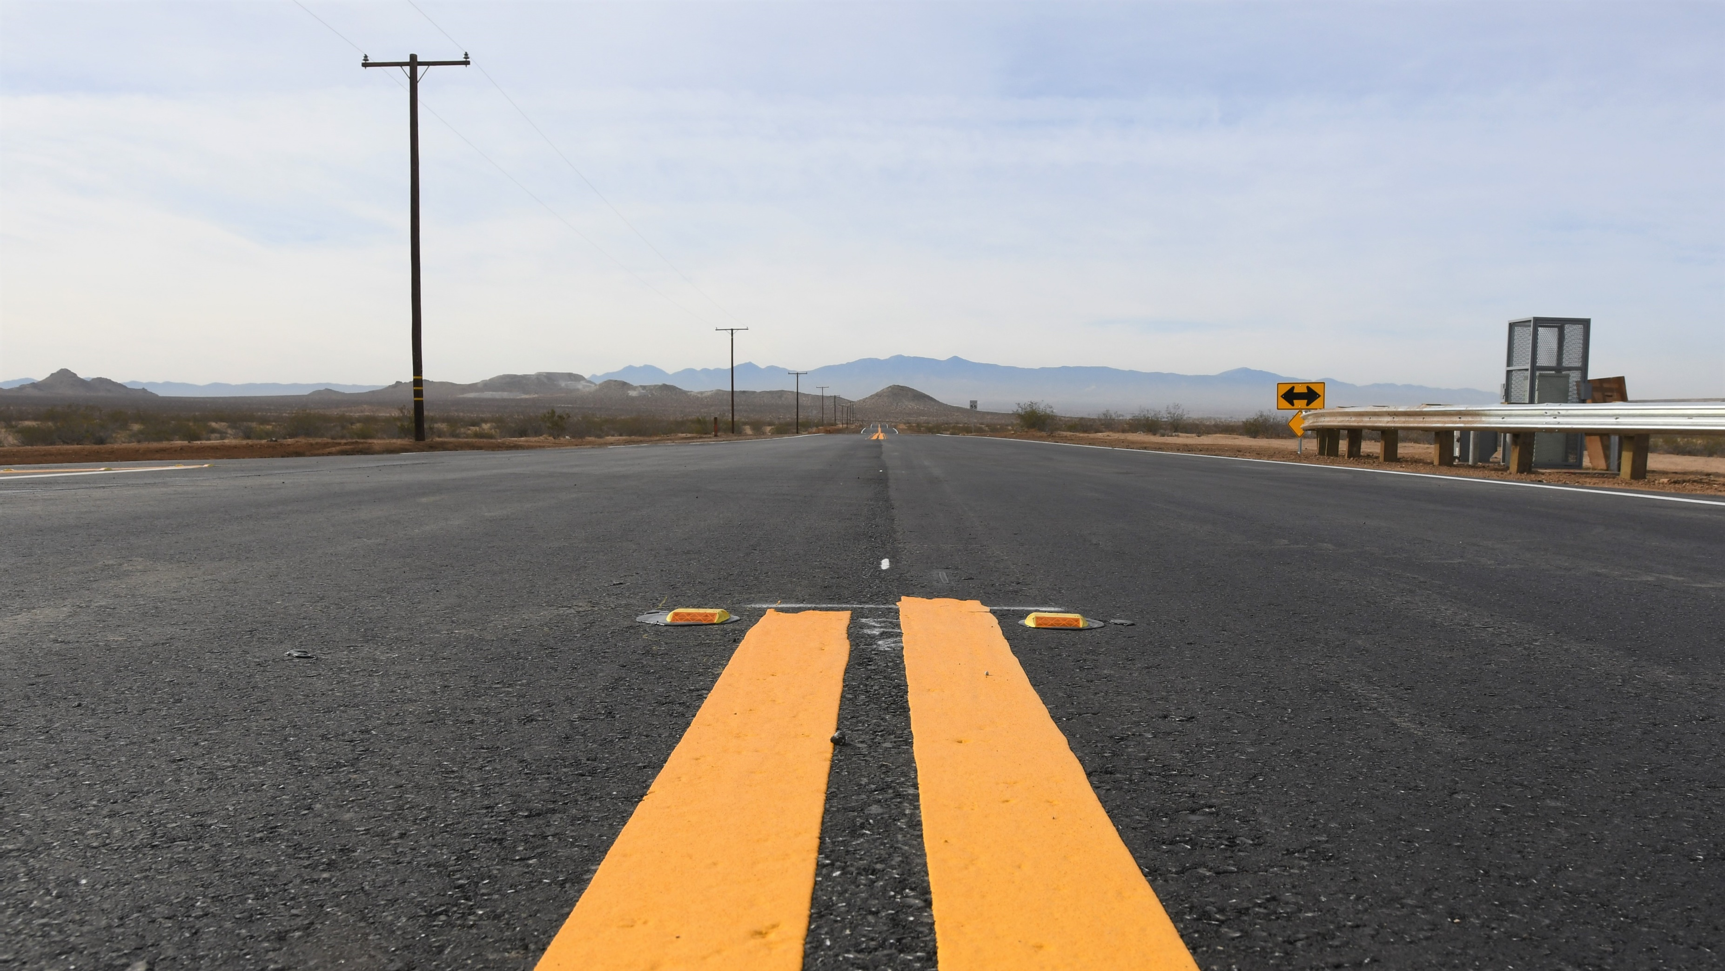
Capital Improvement Projects

Slide 21
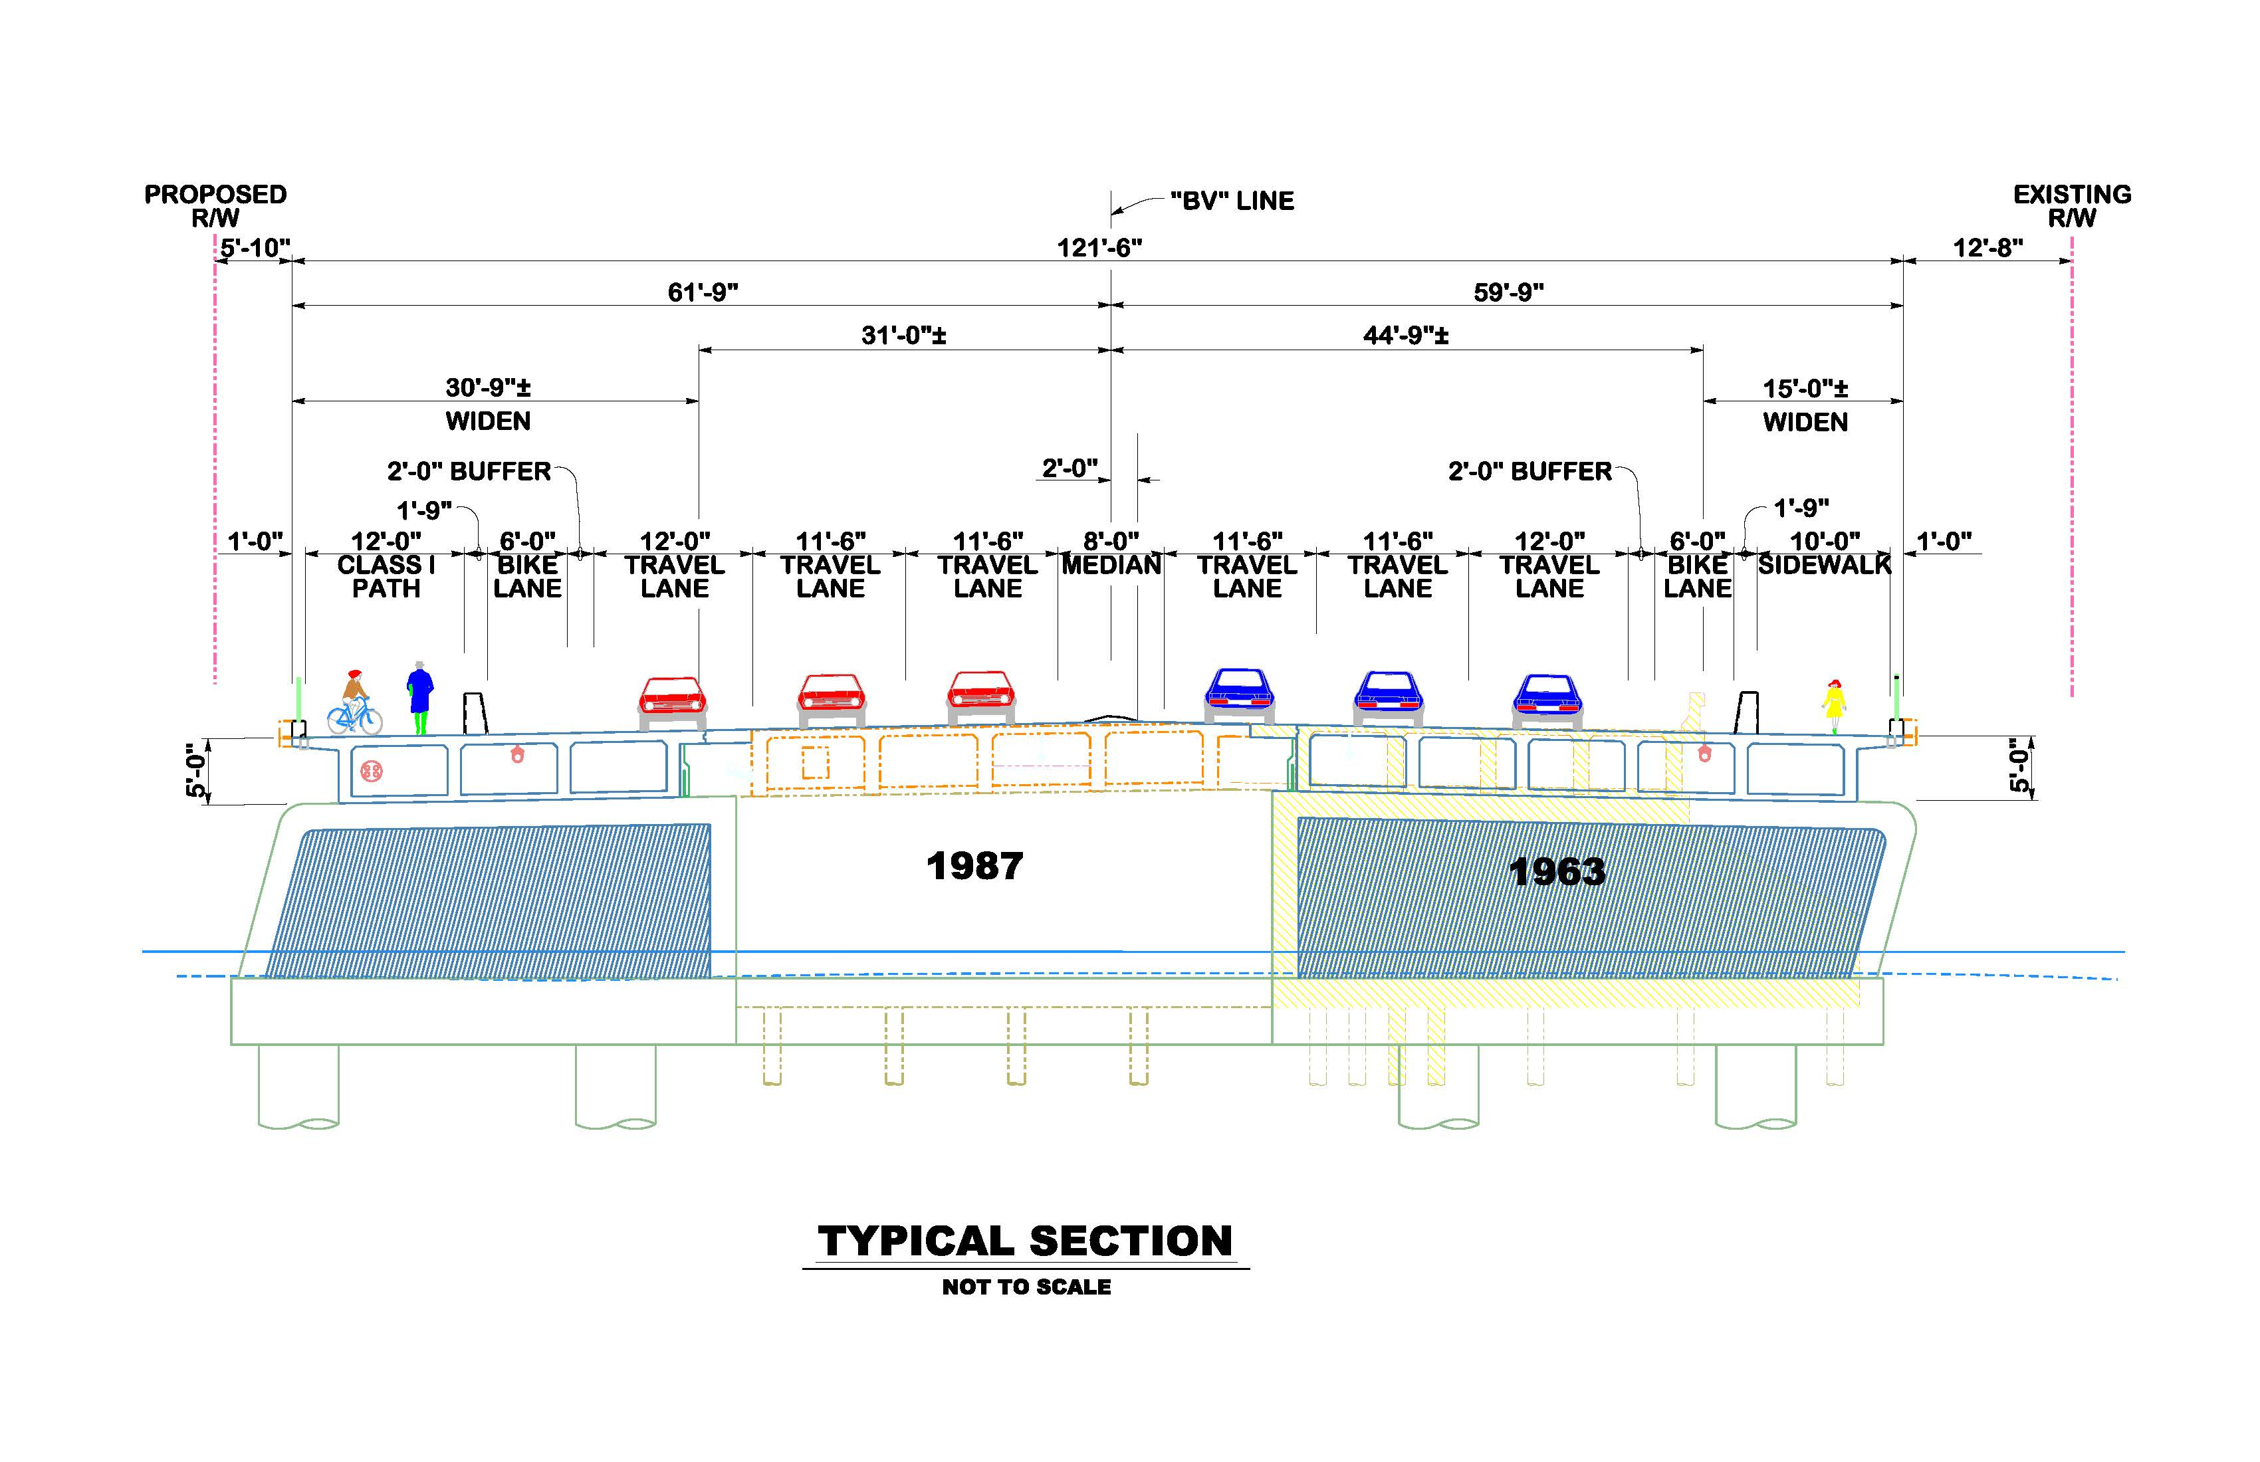
Upcoming Bear Valley Rd Bridge Project

Slide 22
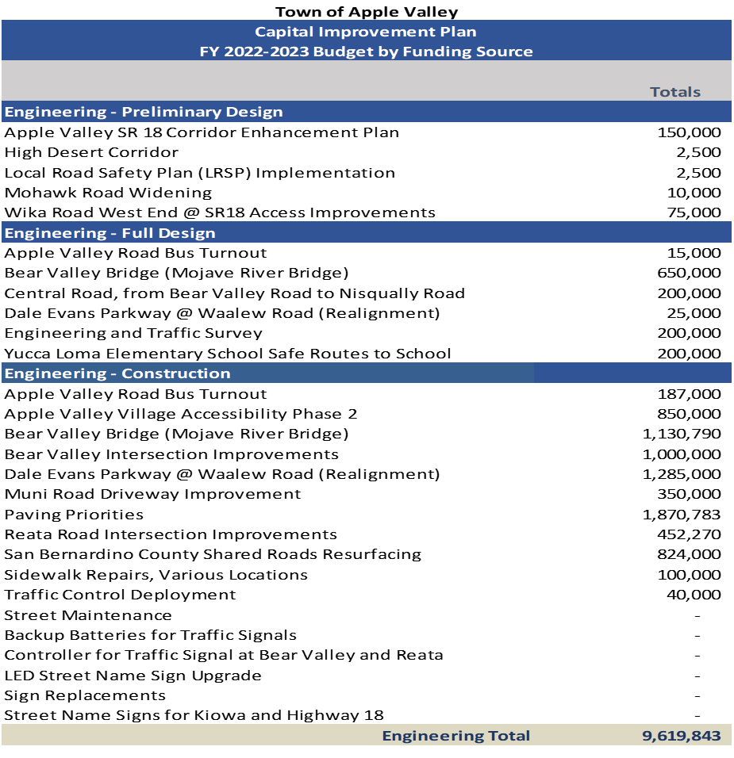

Slide 23
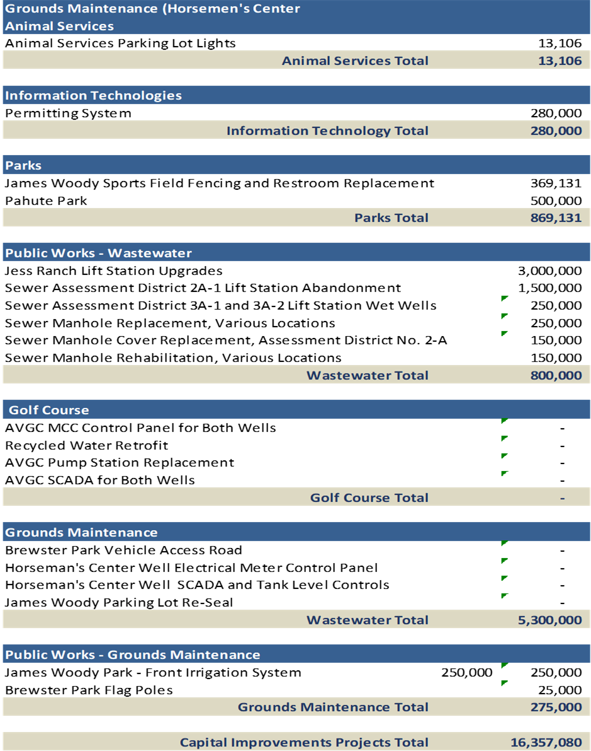

Slide 24
Other Funds Budget Comparison

Slide 25
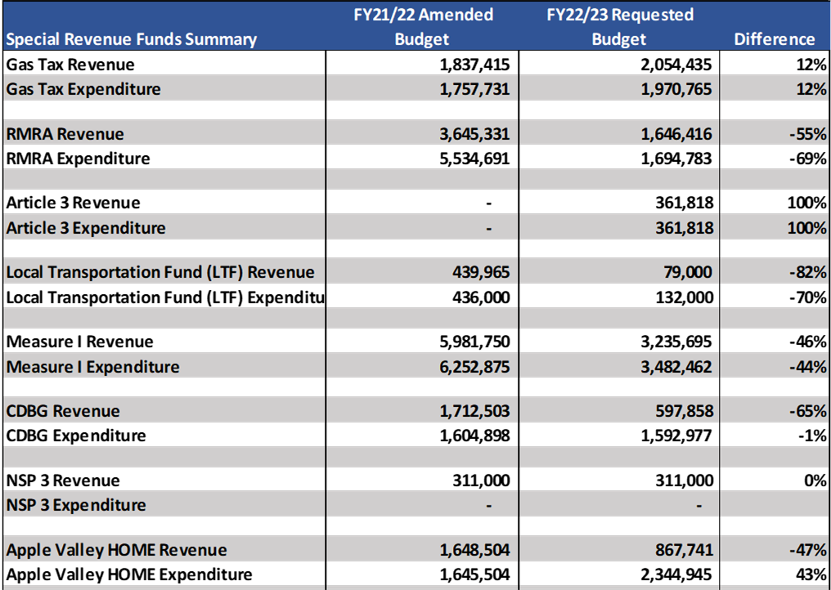
Other Funds Budget Comparison

Slide 26
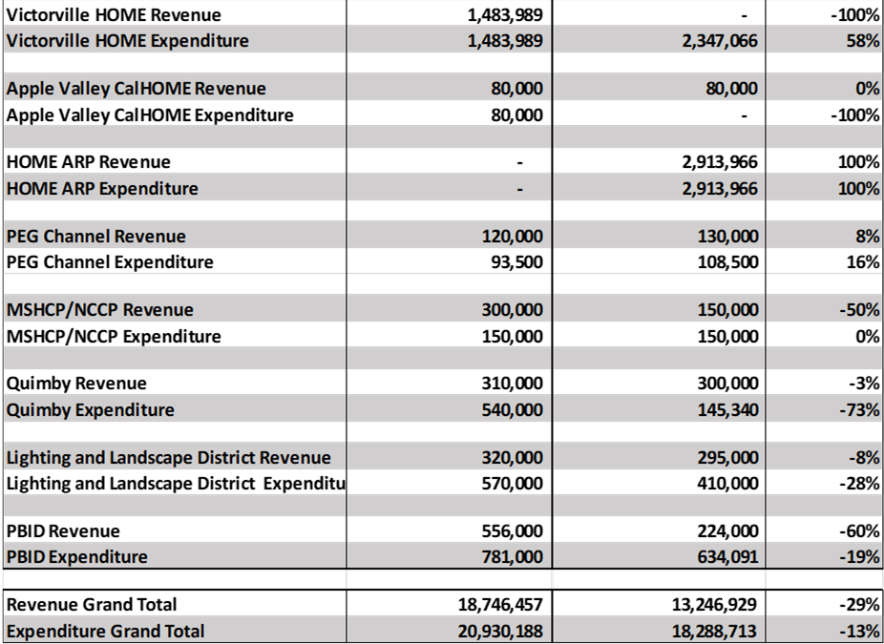
Other Funds Budget Comparison

Slide 27
Forward
American Rescue Plan Act (ARPA) 2nd tranche received June Fiscal Year 2022. No further resources/funds expected from this Act.
Potential cap on Public Safety allocation (%) to General Fund.
Reserve Policy reviews.
Additional, sustained revenue streams to help meet the demand of the expenditure increases.
Utilize limited resources according to community’s priorities.
Pension Forecasts.
Thinking

Slide 28
Pension Forecasts

Slide 29
Questions/Comments

