Slide 1
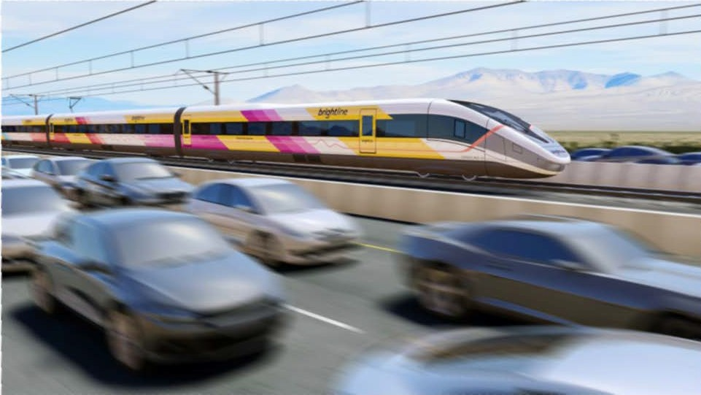

Slide 2
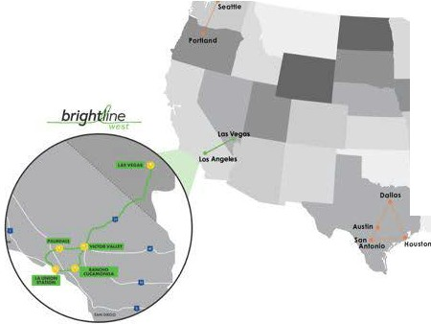
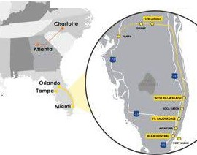
Focused on Bringing Modern, Eco-Friendly Passenger Rail to America
;,.,\:
bright/Jne
SI, lo11lt
COMPANY
GOAL
IS TO CONNECT CITY PAIRS THAT ARE
"TOO LONG TO DRIVE AND TOO SHORT TO FLY"
brighJ/Ln e-
wcs-1

Slide 3
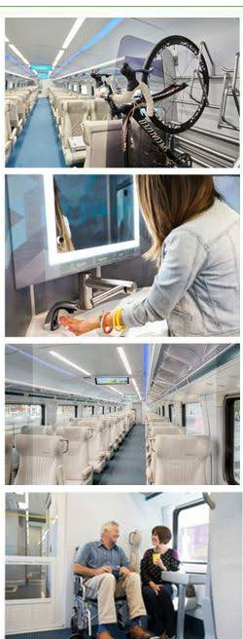
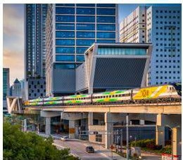
Brightline Florida: Our First Passenger System
Brightline opened in 2018, with stations in Miami, Aventura, Fort Lauderdale Boca Raton and Palm Beach
Expansion to a flagship station in Orlando is underway
Reimagined train travel to be more hospitality focused, driving wide customer satisfaction
Our presence has re-energized neighborhoods, through transit oriented-development
KEY DOWNTOWN LOCATIONS
CURRENT STATIONS
LEAD CUSTOMER SATISFACTION
ll
MIAMICENTRAL
brightline
I
TIii!. 11,1-r,:•c ... ,u.TON
75
75
74
68
63
62
60
43
Ci•
AVENTURA
•,
,-
jetBlue
a.m_az,on
FORT LAUDERDALE
·"..".•'.⁻.".·
,-)
I
BOCA RATON
NETFLIX
II
&')airbnb
West Palm Beach
Miami Central features office, residential and retail
ORLANDO (2023)
brighi/ :f,,

Slide 4
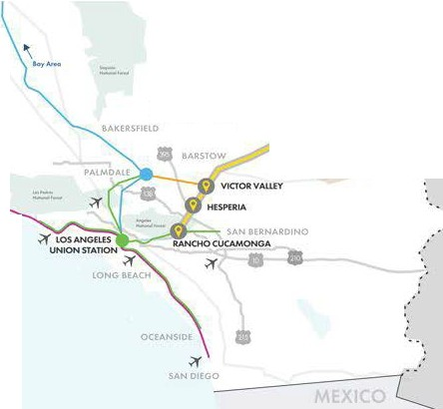
LASvtGAS
Connecting Iconic Destinations
BrighHine stations in las Vegas, Apple Valley, and Rancho Cucamonga
Brightline West System Map
PRIMM .
CALIFORNIA
•
8AKER _
. ' ''
Connecting to LA via direct Metrolink connection
"Local service" being planned for Hesperia
•
SANTA
&AIUl,UA
BrighHine track will run within the 1-15
Building in the 1-15 median and existing transportation corridors
Leverage existing and proven high-speed rail
technology
Capable of making trip between Rancho and Vegas in -2 hours
--·
;:,i- - _{...-w}
..,_......
_...,.,,.,.
-
tl'!lh.s,-flloil
ffltl"hO......C«Nfot
218-mile trip
Las Vegas to Rancho Cucamonga
200MPH
top speed
+11 million
one-way passengers/year

Slide 5
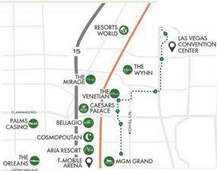
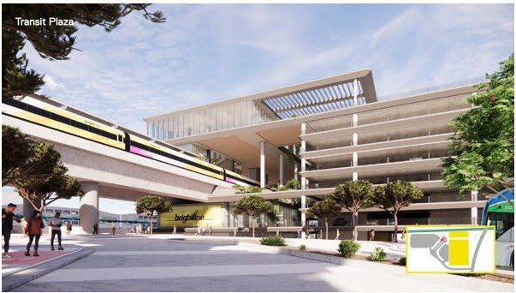
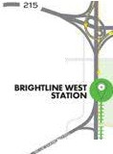
•
California Station Design
Las Vegas Station
.0 \''J,,_i:!'""'
1
- · i \
.,..,..
9 INlt-TION,<
NIC<.UAAN
,..
u
'•
,
IS
f
100
!

Slide 6
Only Shovel-Ready Project to Deliver High-Speed Rail System to America
$
Boost of private capital towardsinfrastructure development
$10 billion project with direct impact on communities
Significant economic impact and job creation
35,000 construction jobs
~1,000 permanent jobs
$10 billion in economic impact
Less traffic on local roadways
Greater connectivity lo car-free transit options
Committed to building and operating trades
Removes 3+ million cars from the road annually
Seamless connections to rail, bus, and other transit for passengers
Workforce diversity, training and career opportunity
More access
to economic centers & new and expanded job markets
Increased real estate value and affordable
development opportunities
Reduce carbon emissions and vehicle miles traveled
Maintain or improve existing wildlife crossings
Engagement with local education communities
Greater regional connectivity spurs economic opportunity
Significant potential development around station sites
400K tons of CO2 removed, 700M VMTs less per year
Applies to 700+ existing crossings
3 Wildlife Overcrossings
Transportation education services, internships, and scholarships

Slide 7
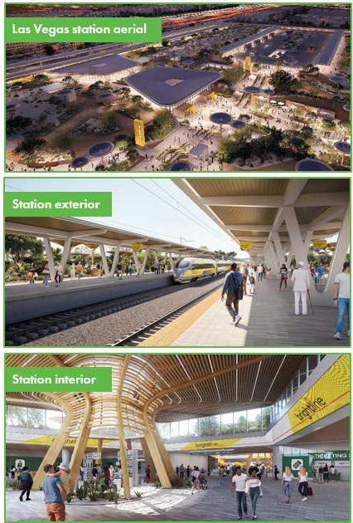
$1OB proiect, mostly to be funded by private dollars
Already invested ~$600M toget 2023 construction-ready
Shovel-Ready Project to Break Ground in 2023
Open for service in ~4 years ahead of 2028 LA Olympics
What we have
,
Land & rights of way
Permits
Construction readiness
brightll ne
west

Slide 8
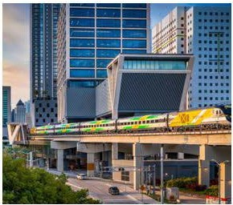
)
75
95
\
ORLANDO STATION
""""°""'
r7 • ,
1-
....l.AMPA STATION
75
MIAMICENTRAL
CURRENT STATIONS
95
MIAMICENTRAL
WESTPALM BE':;;
STATION;
FORTLAUD_{S}E_{T}R_{A}D_{T}1A_{IO}L_{N}E 1·
-
AVENTURA
(
BOCA RATON STATION
75 -
FORT LAUDERDALE
AVENTURA STATION
MlA.MI STATION I
ATMIAMICENTRAL i
BOCA RATON
WEST PALM BEACH
brigh,i(ne
V.'c.;Sl
ORLANDO (2023)

